Slide 1
Introduction to Intelligent User Interfaces
Recommender Systems Basics, Algorithms (content-based, collaborative filtering), Applications

Slide 2
Recommender Systems
Definition
“Recommender Systems (RSs) are software tools and techniques providing suggestions for items to be of use to a user. […] The suggestions relate to various decision-making processes, such as what items to buy, what music to listen to, or what online news to read.” [1, p1]
[1] Francesco Ricci, Lior Rokach and Bracha Shapira. Introduction to Recommender Systems Handbook. In F. Ricci et al. (eds.), Recommender Systems Handbook. Springer Science+Business Media 2011.
Recommender Systems

Slide 3
Recommender Systems – Examples?
How are recommender systems used in these services?
How do recommender systems impact the user experience?
What are user interface patterns used with recommender systems?
Recommender Systems

Slide 4
Recommender Systems
Why are recommender systems used?
What is the main function?
What data do recommender systems require?
How do recommender systems make a user interface intelligent?
Carlos A. Gomez-Uribe and Neil Hunt. 2015. The Netflix Recommender System: Algorithms, Business Value, and Innovation. ACM Trans. Manage. Inf. Syst. 6, 4, Article 13 (December 2015). DOI: https://doi.org/10.1145/2843948
Recommender Systems

Slide 5
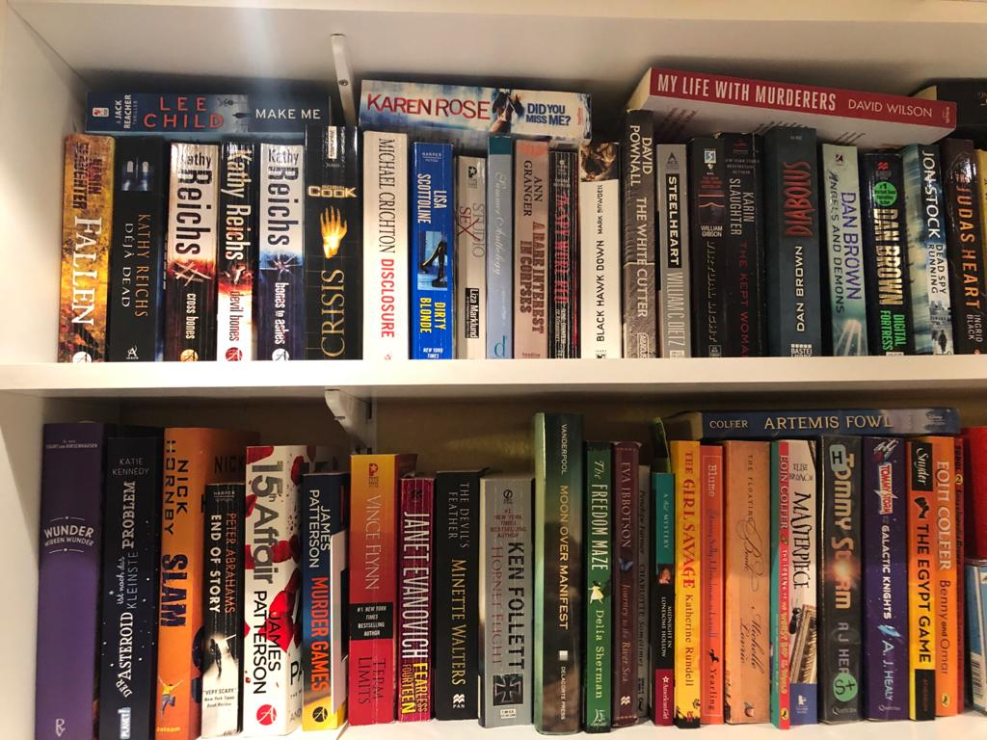
What Book do you Recommend to me?
Recommender Systems
Notes:
Photo Albrecht

Slide 6
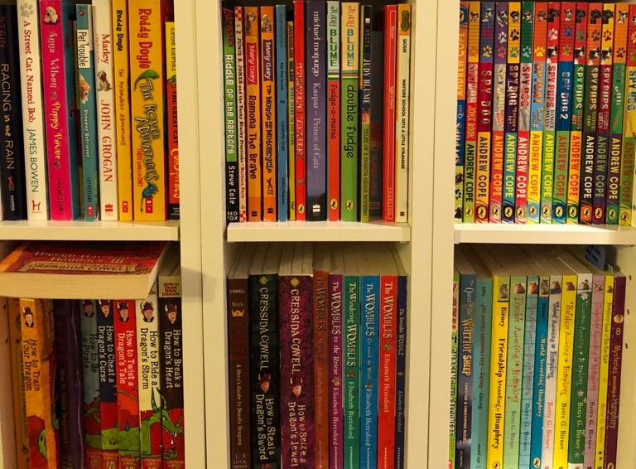
What Book do you Recommend to me?
Recommender Systems
Notes:
Photo Albrecht

Slide 7
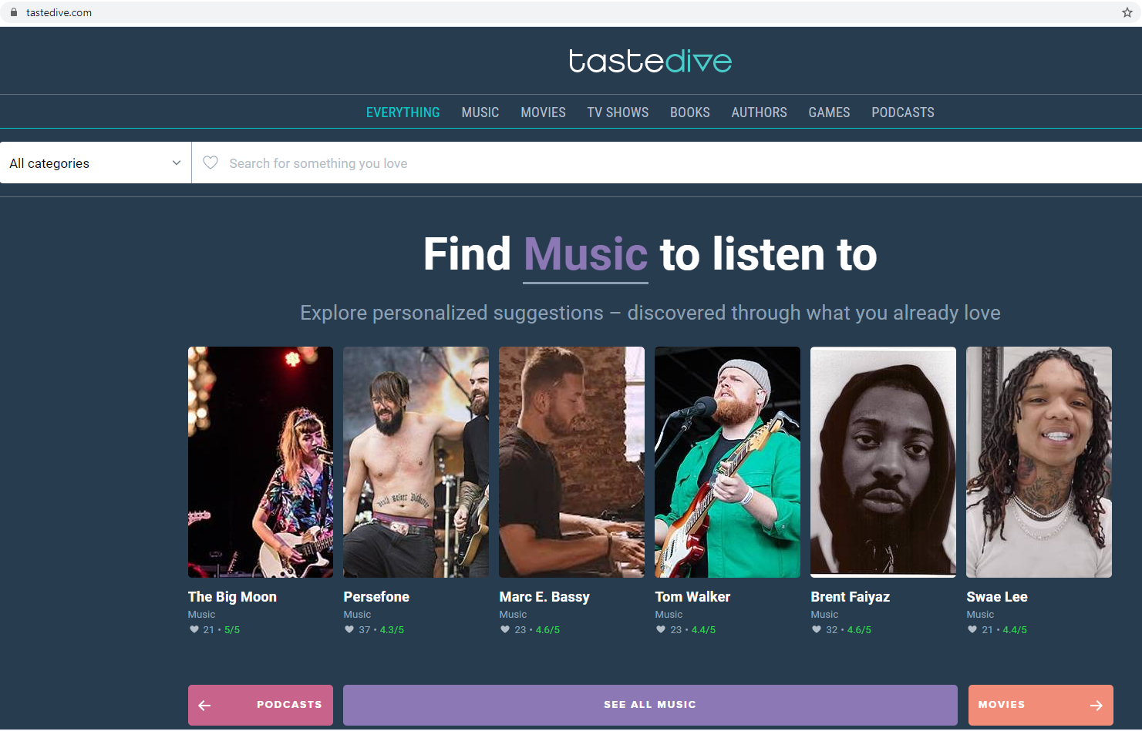
Example: https://tastedive.com/
How does this work?
Recommender Systems

Slide 8
What Book do you Recommend to me?
? ?
Recommender Systems
Notes:
Photo Albrecht

Slide 9
What Book do you Recommend to me?
Content based recommendation
Recommender Systems
Notes:
Photo Albrecht

Slide 10
This is what I read…
Which of these books do you suggest?
Recommender Systems

Slide 11
Approaches to Recommender Systems
Collaborative Filtering “people who liked what you liked also liked X, hence I suggest X to you”
Demographics “many people of you age, income, family status, and education like X, hence I suggest X to you”
Social Relationships “people you hang out with, your friend, or friend of you friends like X, hence I suggest X to you”
Content-based Filtering “X is similar (based on a similarity measure for a domain) to what you liked before, hence I suggest X to you”
Contextual “many people in you current situation/context/location like X, as you are in now this context , I suggest X to you”
Recommender Systems

Slide 12
Content Based Filtering
Basic Approach
What properties / factors / dimensions are describing and discriminating the products? → taxonomy, list of dimensions or set of criteria
Each item can be categorized based on the criteria/dimensions/taxonomy → for each item represent how much it matches these criteria in a vector
How much does the user like products based on the criteria/dimensions/taxonomy? → vector for the user that represents their relationship to these criteria
Identify and recommend items that fit the user’s criteria → calculate the similarity between item vectors and user vectors
Language, genre, time set, main characters, location/setting, theme, length, time written, number of parallel plots, language complexity,…
Recommender Systems

Slide 13
Idea of User Based Collaborative Filtering
liked
liked
liked
Similar
liked
Recommend
liked
Recommender Systems

Slide 14
Recommender Systems

Slide 15
Recommender Systems

Slide 16
Recommender Systems

Slide 17
8 7 9 4 9 10 4 7
2 6 9
4 6 10 8 9 6 7 9 8
4 ? 6 ? ? ? ? 9 5 ? 10 ?
Recommender Systems

Slide 18
Item1 item2 item3 item4 Item5 item6 item7 item8 Item9 item10 item11 item12
u1
8 7 9 4 9 10 4 7
u2
2 6 9
u3
4 6 10 8 9 6 7 9 8
u4
4 ? 6 ? ? ? ? 9 5 ? 10 ?
Recommender Systems

Slide 19
Breakout Sessions 1 How to get item ratings?
Explicitly and Implicitly
Scenario 1: Web based reading platform/library
Scenario 2: Public transport application
Scenario 3: Online platform for travel recommendations
What do you get ratings for? What is the item?
What relevant questions can you ask to get item ratings?
How do you get implicit ratings from “automated observation”?
Recommender Systems

Slide 20
Discussion: Getting user input?
Where does Ethics come in?
Recommender Systems

Slide 21
Recommender Systems Getting user data
What are ways to get data from the user for recommender systems?
Explicit:
Questionnaires at setup time
Ratings of items
Feedback questions
Implicit
Using items (e.g. watching a movie, listen to music, putting something on a watch list, buying a book)
Sharing items (e.g. recommending an article, retweets)
Removing items (e.g. deleting a playlist, skipping a suggested song)
Recommender Systems

Slide 22
Collaborative Filtering
Basic Approach
Tables:
User, Item, Rating
Item, Item description
Approach
Users rate items (implicitly, explicitly), e.g. like a movie, buy a book, recommend an hotel, …
→ Table: user, item, rating
Compute similarity between users (or between items)
→ set of users (or set of items) that is similar to the user (the item) we create a recommendation for
Predict items (new to the target user) based on the information of similar users
→ weighted list of recommendations
Recommender Systems

Slide 23
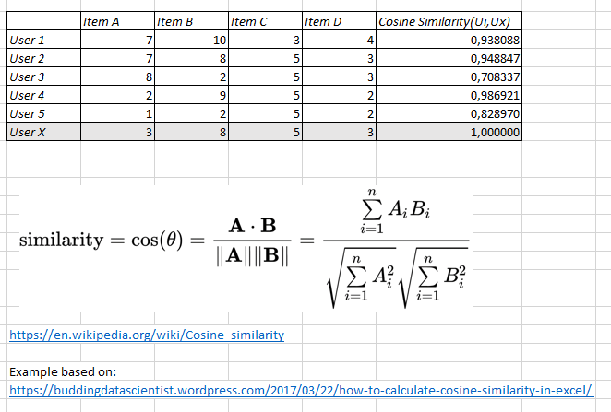
Calculating the similarity
How similar are user to each other?
Calculating the difference between rating vectors, e.g. k-nearest neighbor, Euclidian distance, Pearson correlation, Cosine distance
Heuristic required for tables with missing values!
Recommender Systems

Slide 24
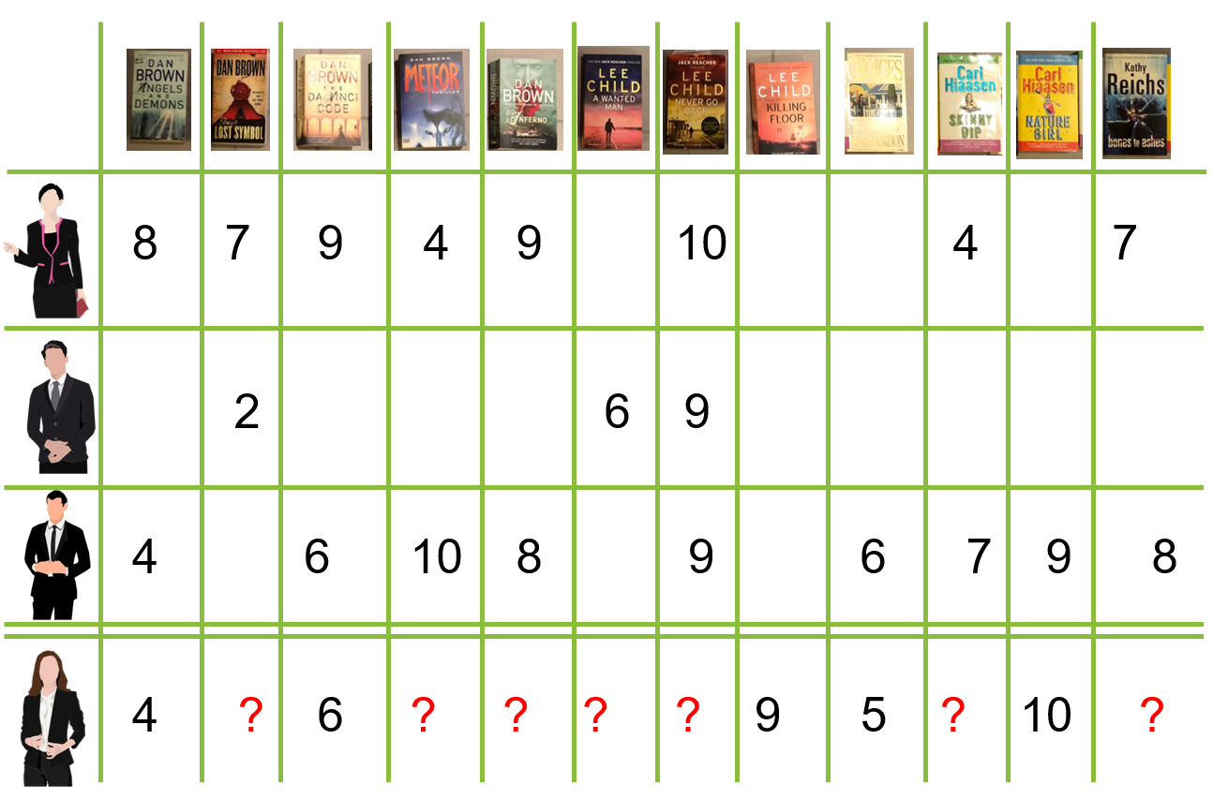
Assessing Similarity?
How could Machine Learning play a role here?
Recommender Systems

Slide 25
Predicting the right item?
Recommender Systems

Slide 26
Example Similarity Matrix
Similarities are NOT calculated – for illustration only
Similarity Matrix
0.4
0.7
0.9
1
Based on https://medium.com/swlh/how-to-build-simple-recommender-systems-in-python-647e5bcd78bd
Recommender Systems

Slide 27
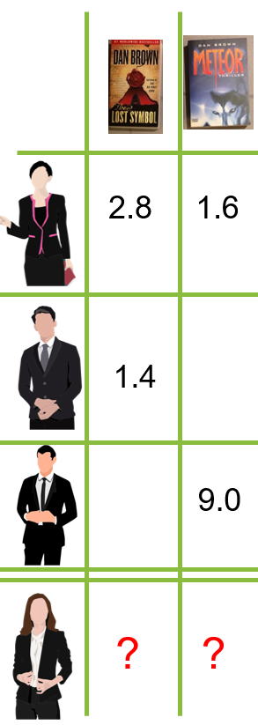
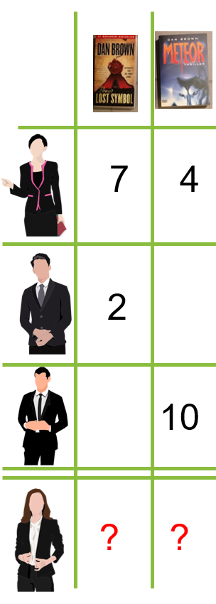
Weighted Rating Matrix
Rating Matrix (part)
Similarity Matrix
Weighted Rating Matrix (part)
*
*
*
0.4
=
=
=
0.7
0.9
1
Based on https://medium.com/swlh/how-to-build-simple-recommender-systems-in-python-647e5bcd78bd
Recommender Systems

Slide 28
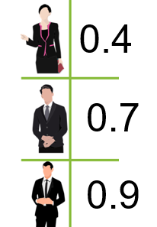
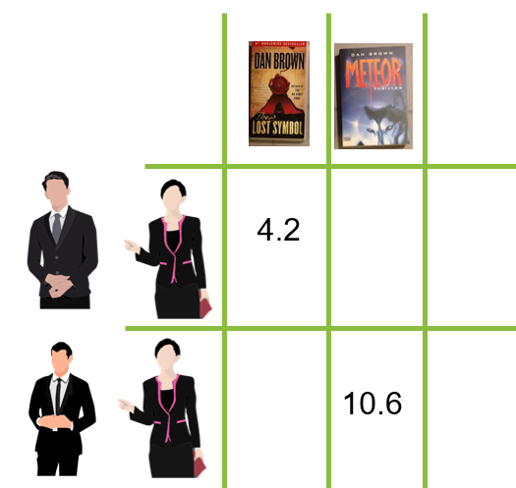
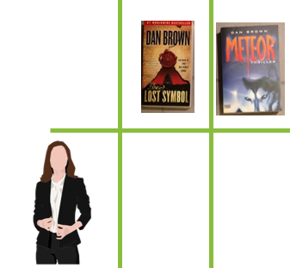
Recommendation
Similarity Matrix
Weighted Rating Matrix (part)
Summing up weights
0.4+0.7
/
/
3.8
8.2
0.4+0.9
Summing up weighted ratings
Based on https://medium.com/swlh/how-to-build-simple-recommender-systems-in-python-647e5bcd78bd
Recommender Systems

Slide 29
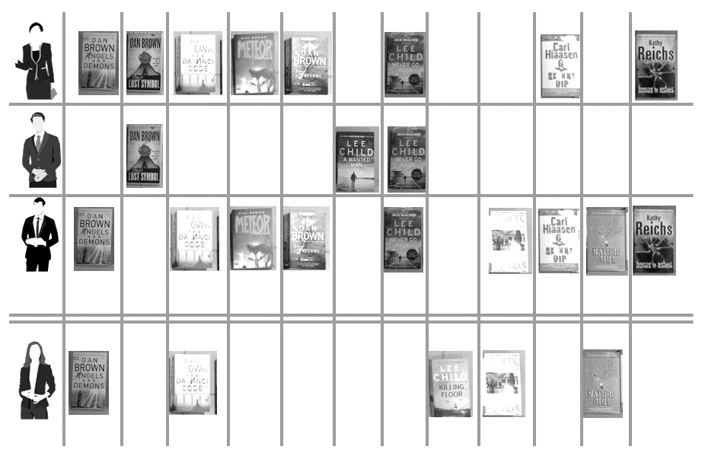
Recommender Systems

Slide 30
Collaborative Filtering
User Based
Calculate similarity between users
Suggest items that similar users liked
Item Based
Calculate similarity between items based on user ratings – no semantics are required!
Suggest item that is similar to item the user already likes
Recommender Systems

Slide 31
Cold-Start Problem
What is n
Basic problem: as a system is created data is missing. The algorithms need initial information (e.g. to calculate similarities).
What could be new? What is the problem?
User: no information yet, no recorded interaction nor know preferences
Item: the item has not been “like” or viewed by anyone yet, no knowledge who may like it or how its rating are similar
Community: new system is created, lack of information about users as well as item
Solutions?
Hybrid approaches (e.g. using content based filtering to get started and then move more towards collaborative filtering)
Use social, demographics, context, content to get started
Require initial interaction (e.g. questionnaire, ask for examples, …)
[1] Bobadilla, Jesús; Ortega, Fernando; Hernando, Antonio; Bernal, Jesús (February 2012). "A collaborative filtering approach to mitigate the new user cold start problem". Knowledge-Based Systems. doi:10.1016/j.knosys.2011.07.021.
[2] https://en.wikipedia.org/wiki/Cold_start_(recommender_systems)
Recommender Systems

Slide 32
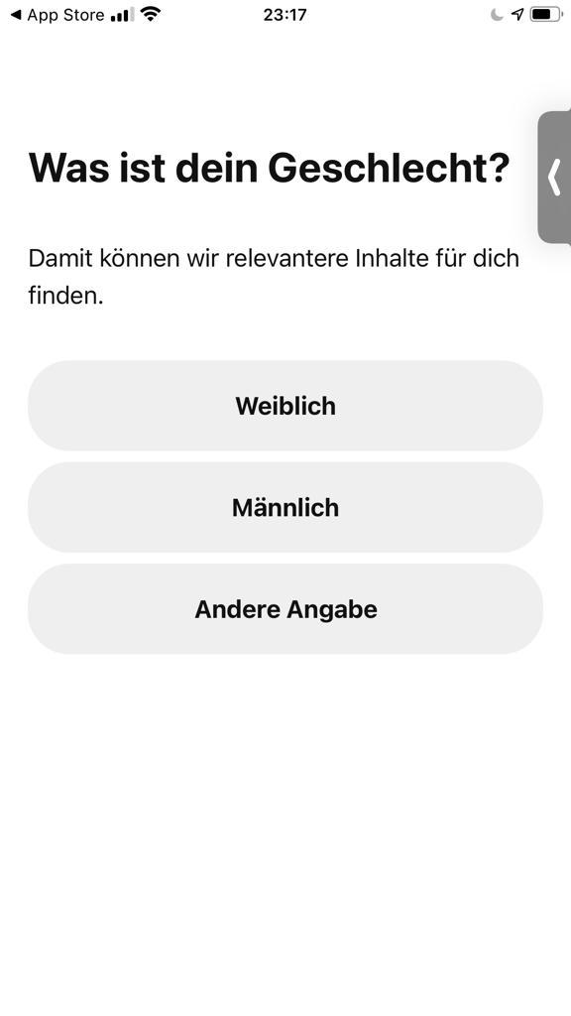
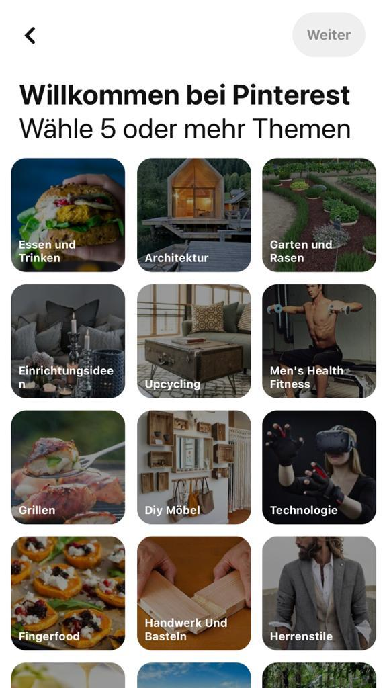
Pinterest
Registration Process and start-up
Demographics Contextual Explicit Interest
Recommender Systems

Slide 33
How to include new item?
Scenario: News Feed
You create a recommender system for a news feed in social media (e.g. twitter style).
How do you add new articles?
Assuming you get a lot of articles….
Recommender Systems

Slide 34
Sparseness of Ratings
E.g. Amazon (low estimates for illustration only)
Over 10 Million products
Over 100 Million customer
What is the problem?
Recommender Systems

Slide 35
What Book do you Recommend to me? Why does the UI matter?
Recommender Systems
Notes:
Size → bigger → more books that I can show… makes it massively easier…

Slide 36
Breakout Sessions 2 Recommendation and User Interface
How can you measure the quality of the user experience of a recommender system?
How does the screen size impact the performance of a recommender system?
Recommender Systems

Slide 37
Recommender Systems Summary
Content-based
Collaborative Filtering
Based on the similarity of items
How similar is a new item to an item already liked/watched/bought by the user
Advantage
If similarity is known or can be calculated, no ratings/actions from the user are required
Difficulty:
Information/meta-data/algorithms for calculating similarity are required
suggestions are made based on users that had similar interests/actions
How has a similar user liked this item?
Advantage:
Know knowledge about the item is required, no meta data or similarity calculation of items required
Difficulty:
Data about other users is required
“cold-start” problem
Recommender Systems

Slide 38
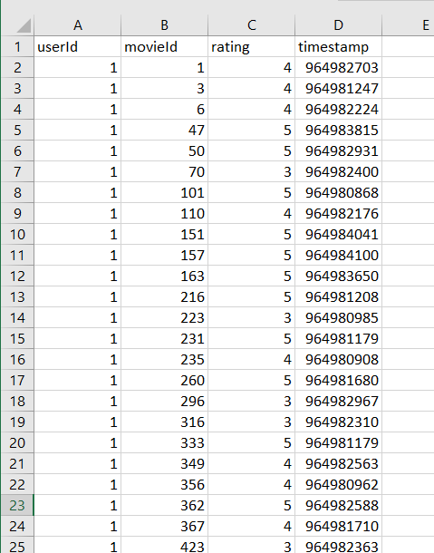
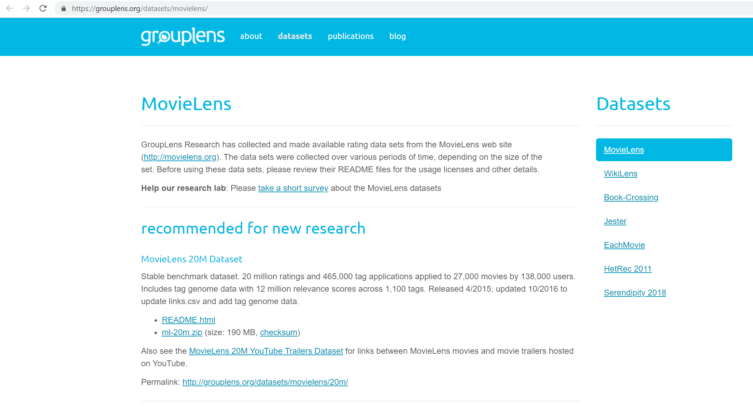
Example data for experiments
https://grouplens.org/datasets/movielens/
Additional reading material: https://hub.packtpub.com/recommending-movies-scale-python/
Recommender Systems

Slide 39
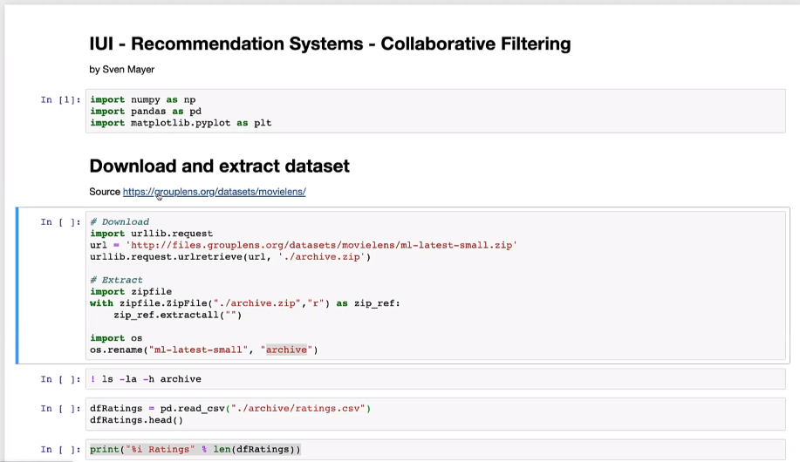
Live coding example

Slide 40
Breakout Sessions 3 Recommender System
Design a systems that suggest educational videos on YouTube that fit your lectures in this term
Recommender Systems

Slide 41
Algorithms for Recommender System
Not core to Intelligent User Interfaces
Efficient implementations in libraries
Important to understand the algorithms to get the parameters right
Many online resources, .e.g.
https://www.youtube.com/watch?v=Eeg1DEeWUjA (introductory video)
https://www.youtube.com/watch?v=Gf4HZpZAlDA https://www.youtube.com/watch?v=b8YyIVulszQ (details on Collaborative Filtering Algorithms)
Recommender Systems

Slide 42
Examples for recommender systems in Python
https://www.youtube.com/watch?v=z0dx-YckFko
https://kerpanic.wordpress.com/2018/03/26/a-gentle-guide-to-recommender-systems-with-surprise/
https://www.analyticsvidhya.com/blog/2016/06/quick-guide-build-recommendation-engine-python/
https://medium.com/@connectwithghosh/recommender-system-on-the-movielens-using-an-autoencoder-using-tensorflow-in-python-f13d3e8d600d
Recommender Systems

