Slide 1
Introduction to Intelligent User Interfaces
Text and Natural Language Processing

Slide 2
Overview - NLP
Definition and Motivation
Applications
Terms, basic concepts and algorithms
Milestones in the history of NLP
Text Analytics

Slide 3
Overview - NLP
Definition and Motivation
Applications
Terms, basic concepts and algorithms
Milestones in the history of NLP
Text Analytics

Slide 4
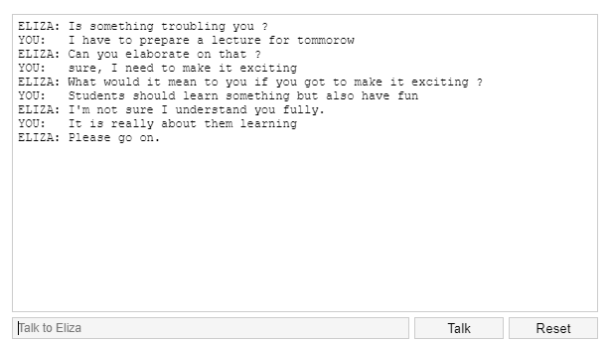
ELIZA by Joseph Weizenbaum
https://katzlberger.ai/2018/08/31/eliza-der-erste-chatbot/
Weizenbaum, Joseph. "ELIZA---a computer program for the study of natural language communication between man and machine." Communications of the ACM 9.1 (1966): 36-45. https://cse.buffalo.edu/~rapaport/572/S02/weizenbaum.eliza.1966.pdf

Slide 5
ELIZA by Joseph Weizenbaum (1966)
“ELIZA is a program […] which makes certain kinds of natural language conversation between man and computer possible. Input sentences are analyzed on the basis of decomposition rules which are triggered by key words appearing in the input text. Responses are generated by reassembly rules associated with selected decomposition rules. The fundamental technical problems with which ELIZA is concerned are:
the identification of key words,
the discovery of minimal context,
the choice of appropriate transformations,
generation of responses in the absence of keywords, and
the provision of an ending capacity for ELIZA "scripts".”
Weizenbaum, Joseph. "ELIZA---a computer program for the study of natural language communication between man and machine." Communications of the ACM 9.1 (1966): 36-45. https://doi.org/10.1145/365153.365168

Slide 6
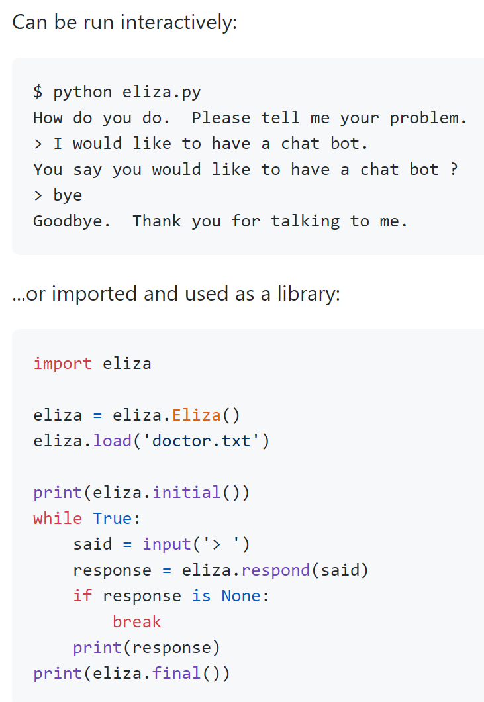
Eliza
Try Eliza out at: http://psych.fullerton.edu/mbirnbaum/psych101/Eliza.htm
Source code in Python: https://github.com/wadetb/eliza

Slide 7
Breakout session
http://psych.fullerton.edu/mbirnbaum/psych101/Eliza.htm
Explore two directions
Assume a conversation with a friend or therapeutic session
Start with: “How can I be more happy?”
Assume you have to answer questions about how many people live in European Capitals?
What reactions do you see?

Slide 8
Task: How to implement a chatbot for Alexa?

Slide 9
NLP timeline three different types of approaches
Since 1950s (early days of NLP): → Rule-based Approaches
Since 1980s (statistical approaches): → Machine Learning Approaches
Since 2010s (advances in neural networks): → Deep Learning Approaches
https://livebook.manning.com/book/essential-natural-language-processing/chapter-1/15

Slide 10
Overview - NLP
Definition and Motivation
Applications
Terms, basic concepts and algorithms
Milestones in the history of NLP
Text Analytics

Slide 11
Text Analytics
Text is a key media:
in personal communication (e.g. texting, email)
in communication media (e.g. news, web pages, social media)
for knowledge sharing and acquisition (e.g. books, reports)
Most user interfaces include texts
Text reception (reading, understanding, or skimming) is often a key factor that defines the require time for a (knowledge work) task
Big individual differences in text reception (e.g. reading speed, understanding)

Slide 12
Definitions of text analytics
Definition of “text data mining”: “as the application of algorithms and methods from the fields machine learning and statistics to texts with the goal of finding useful patterns” [1]
“Text mining is the process of analyzing collections of textual materials in order to capture key concepts and themes and uncover hidden relationships and trends without requiring that you know the precise words or terms that authors have used to express those concepts.” [2]
[1] Hotho, Andreas, Andreas Nürnberger, and Gerhard Paaß. "A brief survey of text mining." Ldv Forum. Vol. 20. No. 1. 2005.
[2] https://www.ibm.com/support/knowledgecenter/en/SS3RA7_17.1.0/ta_guide_ddita/textmining/shared_entities/tm_intro_tm_defined.html

Slide 13
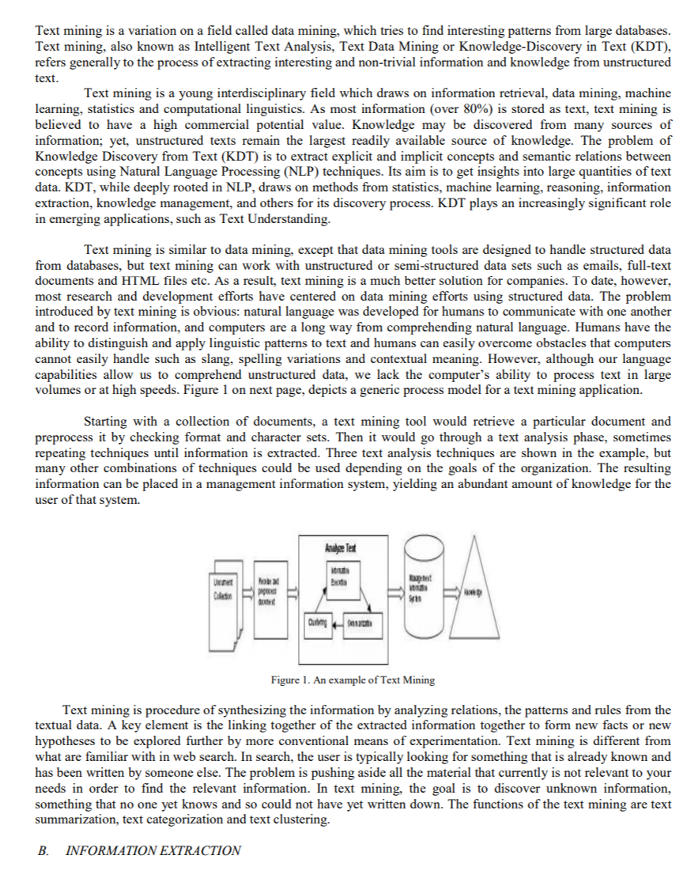
Text analytics – Why and Where?
Answering questions like
What is this text about?
What did the person communicate?
What is the key information in this document?
What feelings are communicated?
Who is saying something?
Is this different from what was said before?
Application areas
Social media analytics, e.g. twitter
Communication and reading interfaces
Customer reviews and feedback
Chat bots
Forensics
http://ijiet.com/wp-content/uploads/2015/04/17.pdf

Slide 14
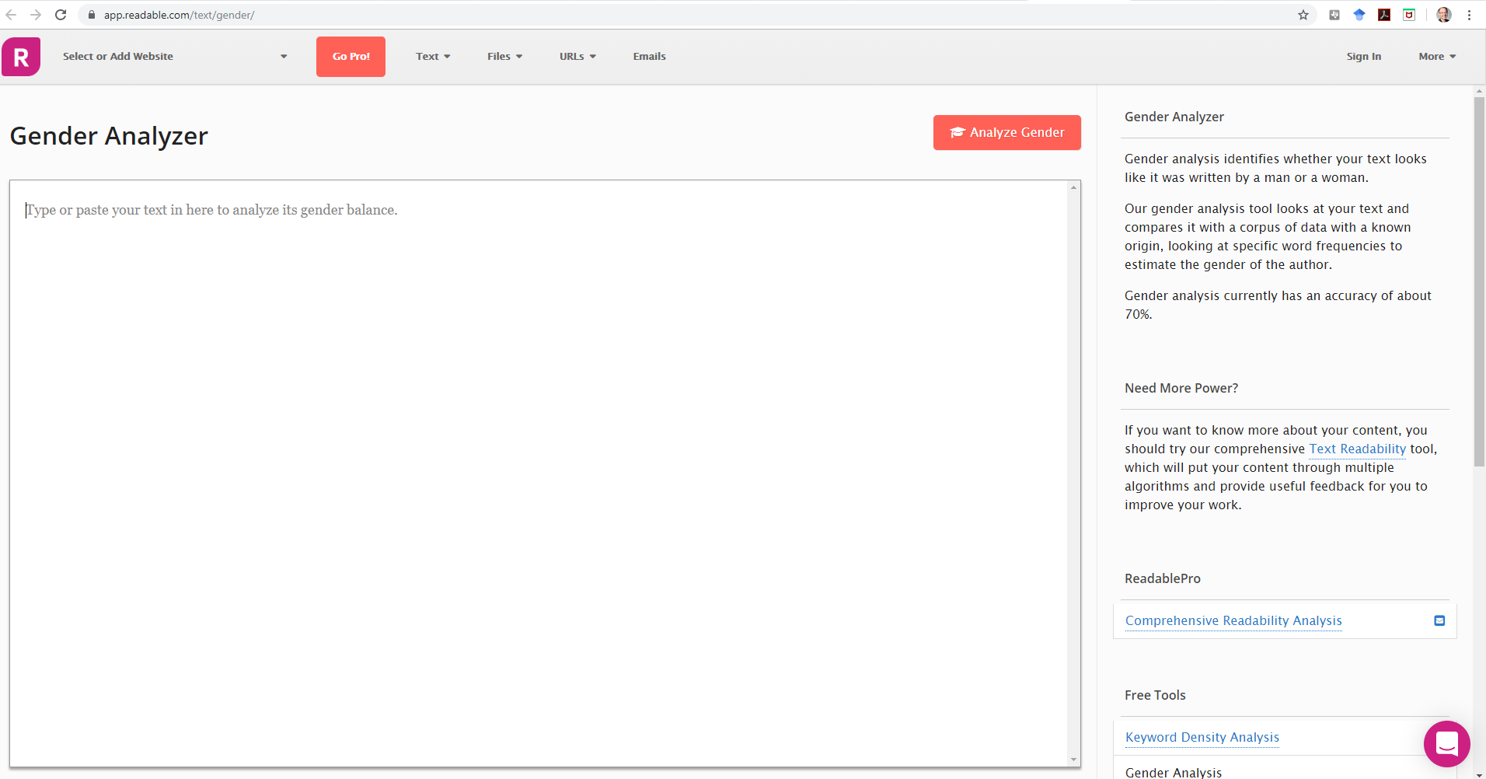
https://app.readable.com/text/gender/
http://www.hackerfactor.com/GenderGuesser.php

Slide 15
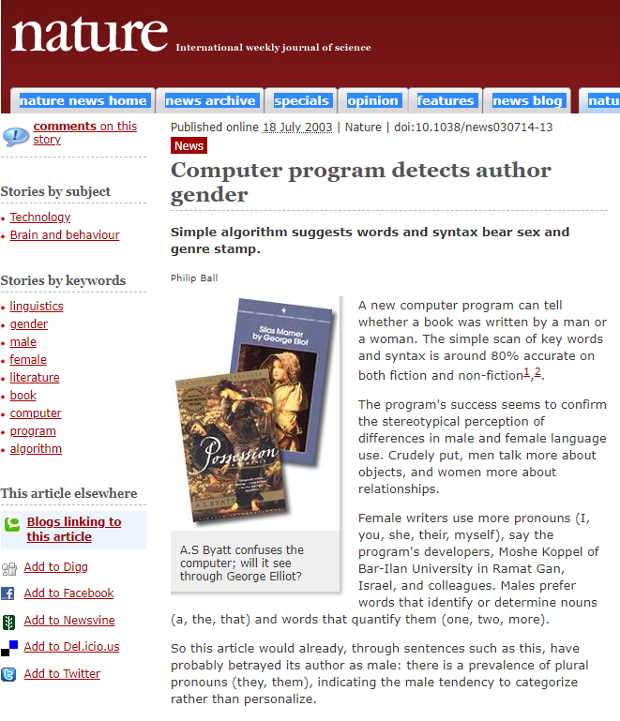
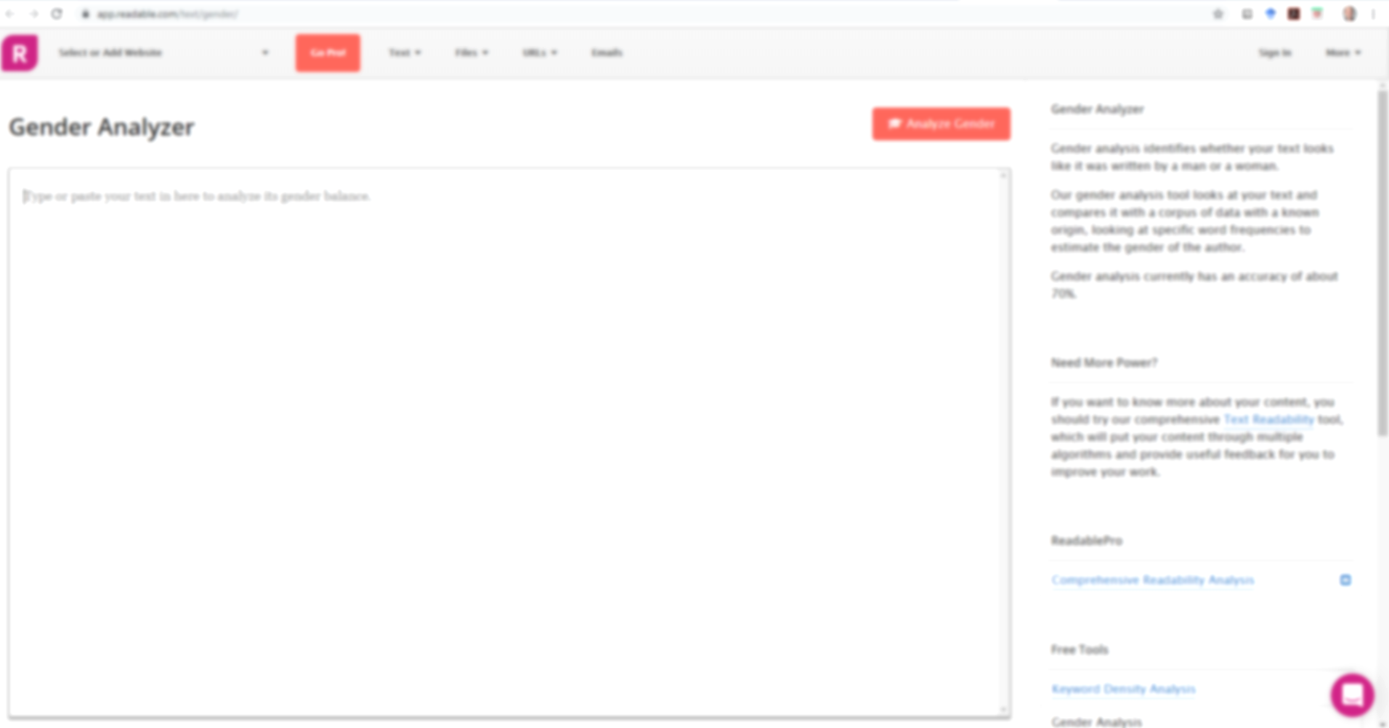
https://www.nature.com/news/2003/030714/full/news030714-13.html
https://app.readable.com/text/gender/

Slide 16
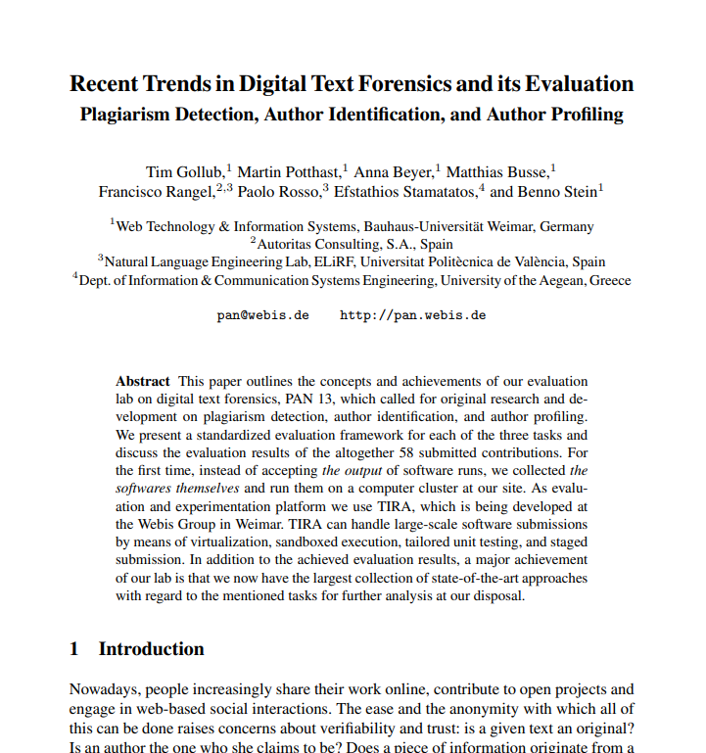
Discussion
Gollub, Tim, et al. "Recent trends in digital text forensics and its evaluation." International Conference of the Cross-Language Evaluation Forum for European Languages. Springer, Berlin, Heidelberg, 2013.
https://webis.de/downloads/publications/papers/stein_2013g.pdf

Slide 17
Text analytics – typical tasks?
Language detection
Named entity extraction
Detecting themes, categories, topics
Detecting intentions
Sentiment analysis
Document summarization
Basis for translation

Slide 18
Text analytics – Identification of the Language
Can tell what language the text is, e.g. English, German, Spanish,…
Relevant for understanding and translation
Example (Online) APIs:
https://console.bluemix.net/apidocs/language-translator
https://docs.microsoft.com/en-us/azure/cognitive-services/translator/
https://cloud.google.com/translate/docs/detecting-language
https://pypi.org/project/langdetect/
Language identification using NLTK, examples
https://avital.ca/notes/language-identification-using-nltk
http://www.algorithm.co.il/blogs/programming/python/cheap-language-detection-nltk/

Slide 19
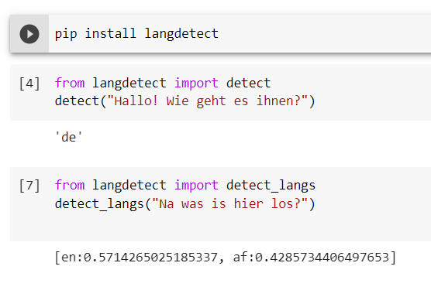
Identification of the Language
https://pypi.org/project/langdetect/

Slide 20
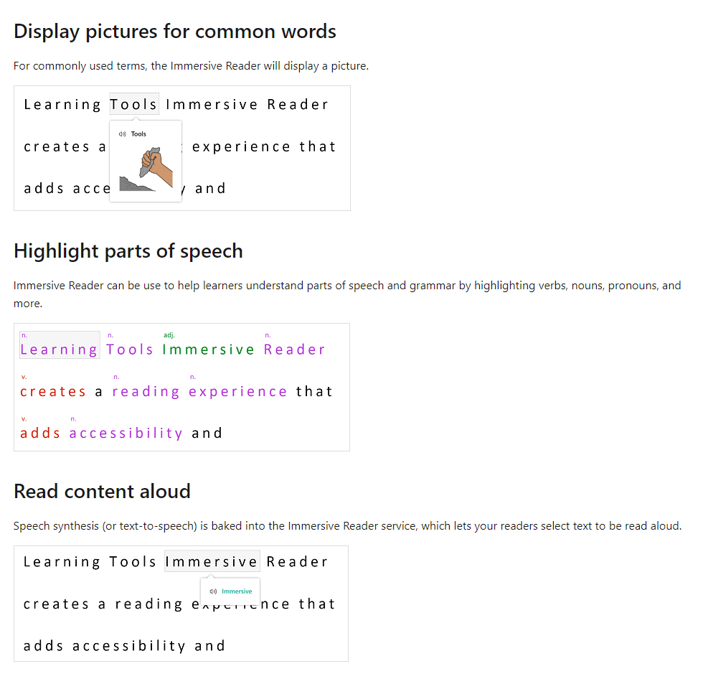
Text Analytics and Interaction Immersive Reader
https://docs.microsoft.com/en-us/azure/cognitive-services/immersive-reader/overview

Slide 21
Text analytics – Sentiment analysis Example – how to… classify reviews?

Slide 22
Text analytics – Sentiment analysis
In the sentiment analysis the algorithm determines if text is positive, neutral, or negative
Used to analyze reports, social media posts, customer reviews, forums, news items, communication, etc.
Typically a text is broken up in parts (e.g. sentences or phrases) and for each part the sentiment is estimated. The score for the parts is then combined to get an overall score
Sentiment library and rules
Sentiment library (collection of adjectives and phrases that are either positive or negative, e.g. good, brilliant, great, amazing)
Rules are used to assign a sentiment score based on the library and rules
Typical problems
“Not good”, “the cake wasn’t bad”, …

Slide 23
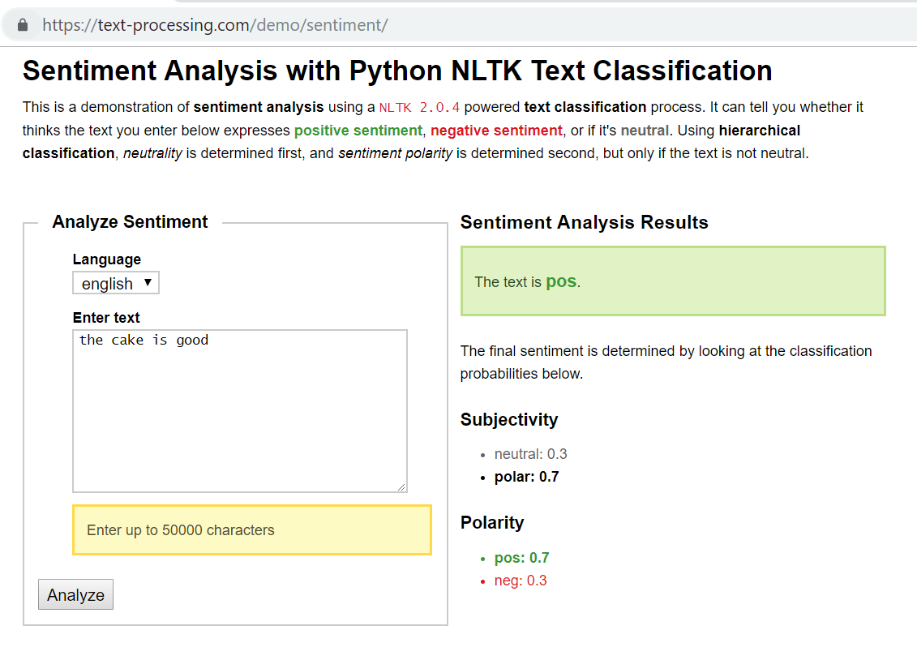
Example: https://text-processing.com/demo/sentiment/
The cake is good The cake is not bad
→ pos: 0.7 → pos: 0.2
→ neg: 0.3 → neg: 0.8

Slide 24
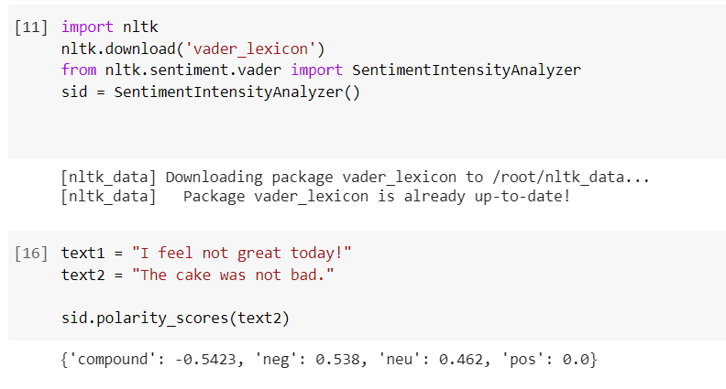
Sentiment analysis

Slide 25
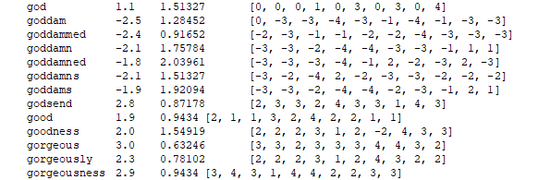
NLTK vader https://www.nltk.org/_modules/nltk/sentiment/vader.html
Sentiment ratings from 10 independent human raters […]. Over 9,000 token features were rated on a scale from "[–4] Extremely Negative" to "[4] Extremely Positive", with allowance for "[0] Neutral (or Neither, N/A)". We kept every lexical feature that had a non-zero mean rating, and whose standard deviation was less than 2.5 as determined by the aggregate of those ten independent raters. This left us with just over 7,500 lexical features […] For example, the word "okay" has a positive valence of 0.9, "good" is 1.9, and "great" is 3.1, whereas "horrible" is –2.5, the frowning emoticon :( is –2.2, and "sucks" and it's slang derivative "sux" are both –1.5.

Slide 26
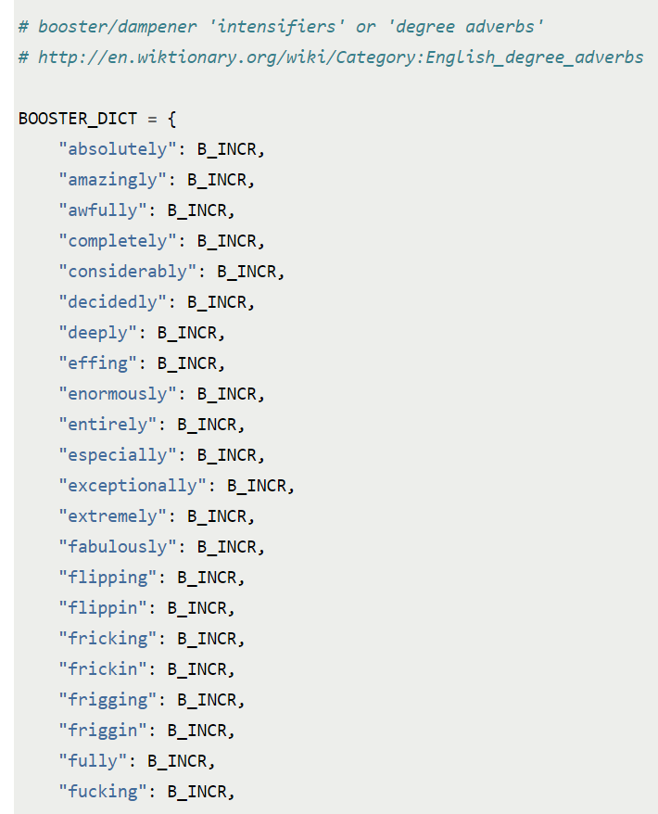
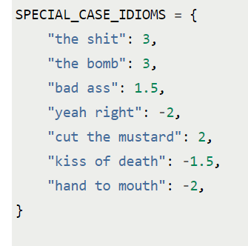
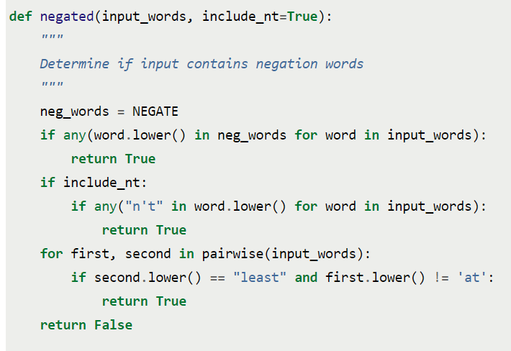
NLTK vader https://www.nltk.org/_modules/nltk/sentiment/vader.html
http://t-redactyl.io/blog/2017/04/using-vader-to-handle-sentiment-analysis-with-social-media-text.html
Hutto, C.J. & Gilbert, E.E. (2014). VADER: A Parsimonious Rule-based Model for Sentiment Analysis of Social Media Text. Eighth International Conference on Weblogs and Social Media (ICWSM-14). Ann Arbor, MI, June 2014.

Slide 27
NLTK vader: https://www.nltk.org/_modules/nltk/sentiment/vader.html
Hutto, C.J. & Gilbert, E.E. (2014). VADER: A Parsimonious Rule-based Model for Sentiment Analysis of Social Media Text. Eighth International Conference on Weblogs and Social Media (ICWSM-14). Ann Arbor, MI, June 2014.
http://t-redactyl.io/blog/2017/04/using-vader-to-handle-sentiment-analysis-with-social-media-text.html

Slide 28
Text analytics – Sentiment analysis
Sentiment Analysis with Python NLTK Text Classification (online example) https://text-processing.com/demo/sentiment/
Twitter Sentiment Analysis using Python https://www.geeksforgeeks.org/twitter-sentiment-analysis-using-python/
nltk.sentiment.sentiment_analyzer module facilitate Sentiment Analysis tasks using NLTK features and classifiers https://www.nltk.org/api/nltk.sentiment.html
https://www.kaggle.com/ngyptr/python-nltk-sentiment-analysis

Slide 29
Text analytics – Summarization
For a given text a short version is created that keep a maximum of the content and should still relay the same message
Important, especially if dealing with a lot of text (reports, social media, communication)
Optimum: Reduce text in a way that only the relevant information remains
Applications:
Reduce reading time for human reader
Improve indexing of documents
Simplify overview of larger texts and collections
Manual text summarization is common
Headings in newspapers, synopses from a book, abstracts in papers, reviews of a film or book
See: https://machinelearningmastery.com/gentle-introduction-text-summarization/

Slide 30
Text analytics – Summarization Example
“So, keep working. Keep striving. Never give up. Fall down seven times, get up eight. Ease is a greater threat to progress than hardship. Ease is a greater threat to progress than hardship. So, keep moving, keep growing, keep learning. See you at work.”
Task: Summarize the above paragraph in 1 sentence. The sentence must not be longer than 10 words.
Example from https://stackabuse.com/text-summarization-with-nltk-in-python/

Slide 31
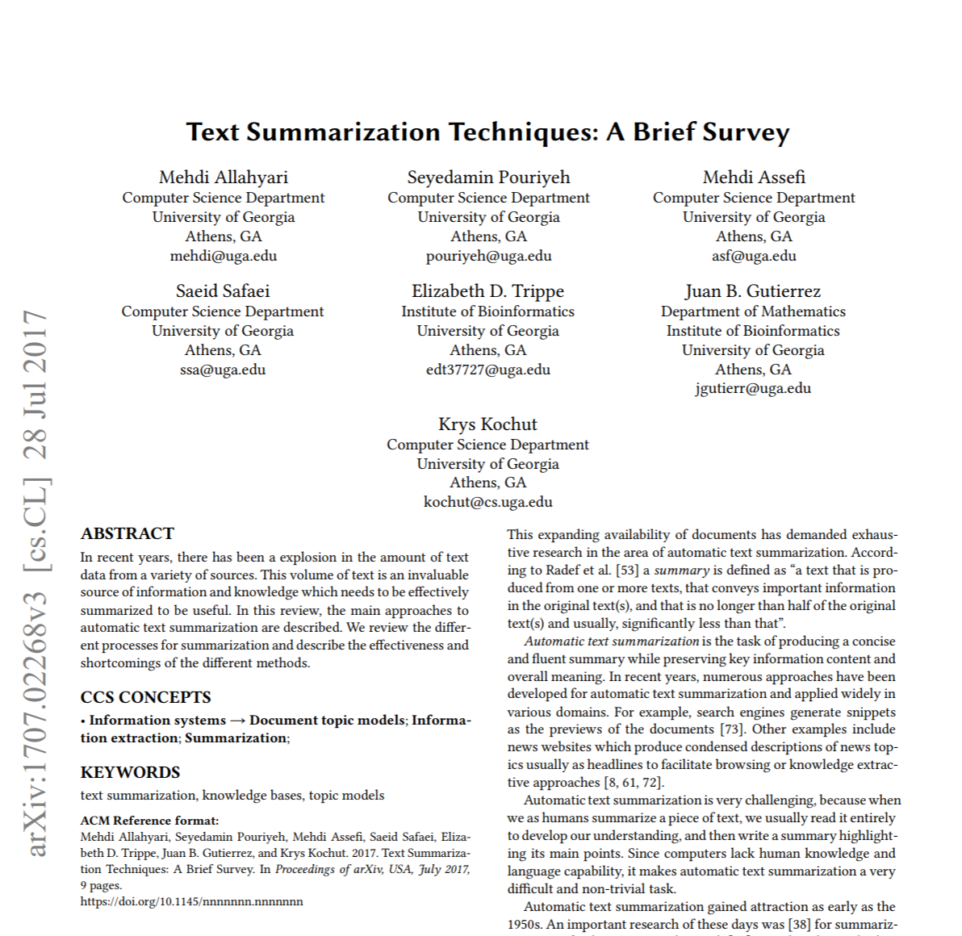
Text analytics – Summarization
Approaches:
Extraction: “identifying important sections of the text and generating them verbatim; thus, they depend only on extraction of sentences from the original text”.
Abstraction: “aim at producing important material in a new way. In other words, they interpret and examine the text using advanced natural language techniques in order to generate a new shorter text that conveys the most critical information from the original text.”
Extraction is easier in typically better than abstraction as it requires less semantic understanding
Mehdi Allahyari et al. Text Summarization Techniques: A Brief Survey. 2017. arXiv:1707.02268 [cs.CL]

Slide 32
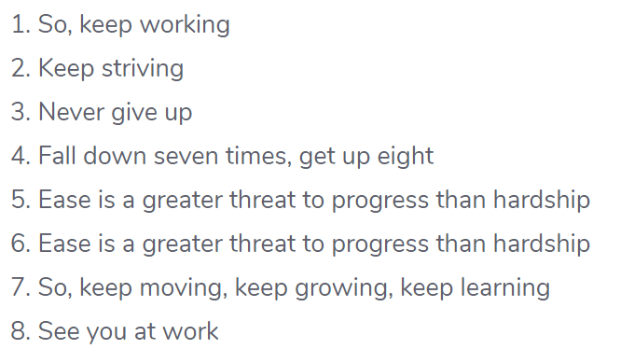
Text analytics – Summarization Example
Step 1: Convert Paragraphs to Sentences
Example from https://stackabuse.com/text-summarization-with-nltk-in-python/

Slide 33
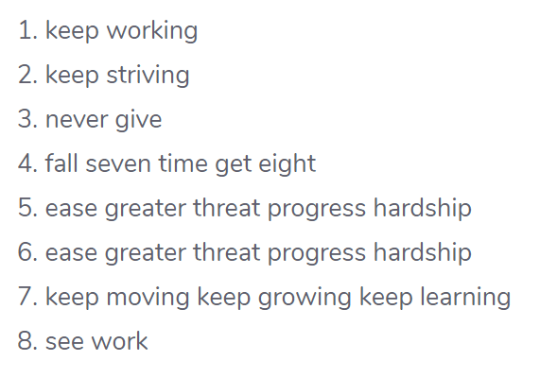
Text analytics – Summarization Example
Step 1: Convert Paragraphs to Sentences
Step 2: Text Preprocessing
Example from https://stackabuse.com/text-summarization-with-nltk-in-python/

Slide 34
Text analytics – Summarization Example
Step 3. Tokens
Step 1: Convert Paragraphs to Sentences
Step 2: Text Preprocessing
Example from https://stackabuse.com/text-summarization-with-nltk-in-python/

Slide 35
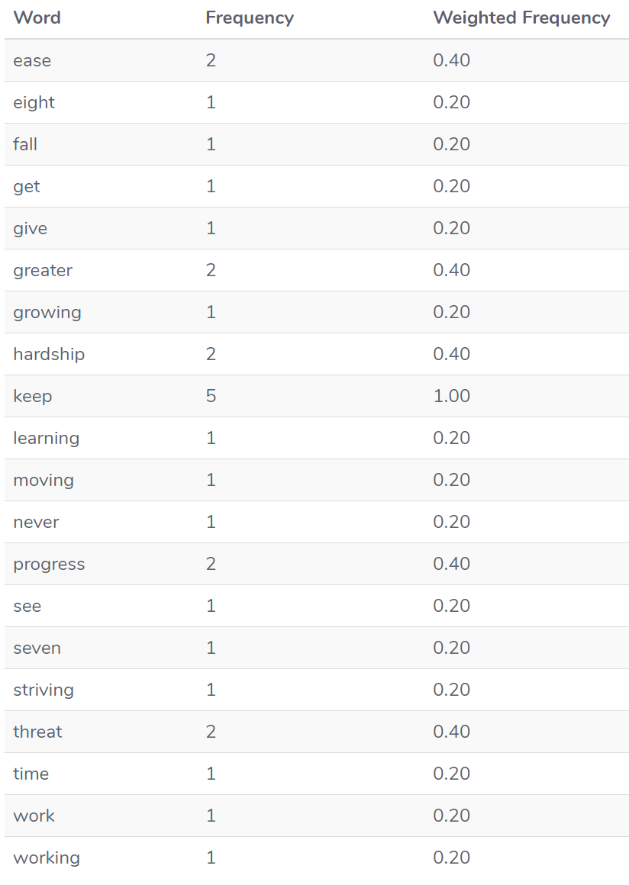
Text analytics – Summarization Example
Step 3. Tokens
Step 4: Find weighted frequency of occurrence
Example from https://stackabuse.com/text-summarization-with-nltk-in-python/

Slide 36
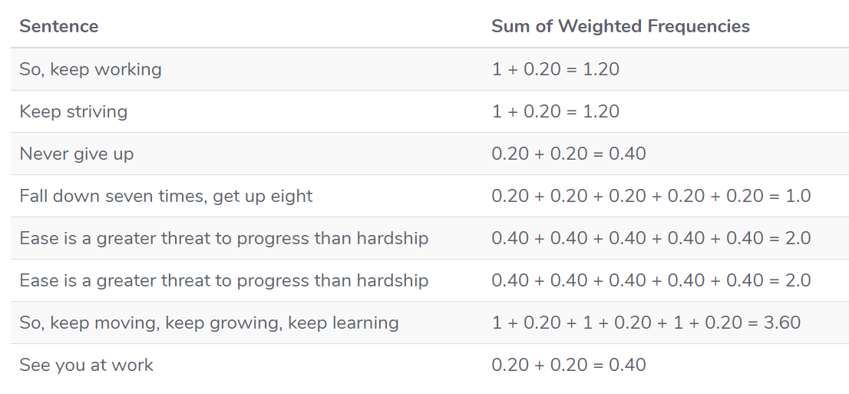
Text analytics – Summarization Example
Step 4: Find weighted frequency of occurrence
5. Replace Words by Weighted Frequency in Original Sentences
Example from https://stackabuse.com/text-summarization-with-nltk-in-python/

Slide 37
Text analytics – Summarization Example
5. Replace Words by Weighted Frequency in Original Sentences
6. Results
Example from https://stackabuse.com/text-summarization-with-nltk-in-python/

Slide 38
Text analytics – Summarization
Explanation: https://rare-technologies.com/text-summarization-in-python-extractive-vs-abstractive-techniques-revisited/
Example: https://stackabuse.com/text-summarization-with-nltk-in-python/ https://medium.com/jatana/unsupervised-text-summarization-using-sentence-embeddings-adb15ce83db1
Libraries and Tools
“PyTeaser takes any news article and extract a brief summary from it. It's based on the original Scala project.” https://github.com/xiaoxu193/PyTeaser

Slide 39
Breakout Group Responsive Design for Text
Example: Email client that summarizes text when resized

Slide 40
Recap … do you remember what we did last time?
Tokenization
Stop Words Removal
Text normalization
Stemming / Porter Stemmer
Lemmatization
Part-Of-Speech Tagging
Named Entity Disambiguation
Named Entity Extraction
Bag of Words
Corpus, Corpora

