Slide 1
Introduction to Intelligent User Interfaces
Text and Natural Language Processing

Slide 2
Overview - NLP
Definition and Motivation
Applications
Terms, basic concepts and algorithms
Milestones in the history of NLP
Text Analytics

Slide 3
Artificial languages and Natural Languages
Syntax and semantic
Vocabulary as set of words
Text a sequence of words
Language all “valid” texts
Notes:
Die Syntax einer Sprache (eines Zeichensystems) beschreibt die Regeln, nach denen die Sprachkonstrukte (Zeichen des Zeichensystems) gebildet werden. ..
. Die Semantik einer Sprache (eines Zeichensystems) beschreibt die Bedeutung der Sprachkonstrukte (Zeichen des Zeichensystems).
Die Pragmatik einer Sprache (eines Zeichensystems) beschäftigt sich mit der Verwendung und Bedeutung von Sprachkonstrukten in konkreten Situationen.
https://www.inf-schule.de/sprachen/sprachenundautomaten/formalesprachen/einfuehrung_zeichensystem/syntaxsemantikpragmatik
Images are free to use:
https://pixabay.com/photos/code-programming-coding-web-2434271/
https://pxhere.com/en/photo/1201393

Slide 4
Natural Language Processing (NLP) A Definition
“Natural Language Processing is a theoretically motivated range of computational techniques for analyzing and representing naturally occurring texts at one or more levels of linguistic analysis for the purpose of achieving human-like language processing for a range of tasks or applications.”
Liddy, E.D. 2001. Natural Language Processing. In Encyclopedia of Library and Information Science, 2nd Ed. NY. Marcel Decker, Inc.

Slide 5
Natural Language Processing (NLP) A Definition
“Natural Language Processing is a theoretically motivated range of computational techniques for analyzing and representing naturally occurring texts at one or more levels of linguistic analysis for the purpose of achieving human-like language processing for a range of tasks or applications.”
Liddy, E.D. 2001. Natural Language Processing. In Encyclopedia of Library and Information Science, 2nd Ed. NY. Marcel Decker, Inc.
Notes:
https://surface.syr.edu/cgi/viewcontent.cgi?article=1043&context=istpub

Slide 6
Natural Language Processing (NLP) A Definition
“Natural Language Processing is a theoretically motivated range of computational techniques for analyzing and representing naturally occurring texts at one or more levels of linguistic analysis for the purpose of achieving human-like language processing for a range of tasks or applications.”
Liddy, E.D. 2001. Natural Language Processing. In Encyclopedia of Library and Information Science, 2nd Ed. NY. Marcel Decker, Inc.

Slide 7
Natural Language Processing (NLP) A Definition
“Natural Language Processing is a theoretically motivated range of computational techniques for analyzing and representing naturally occurring texts at one or more levels of linguistic analysis for the purpose of achieving human-like language processing for a range of tasks or applications.”
Liddy, E.D. 2001. Natural Language Processing. In Encyclopedia of Library and Information Science, 2nd Ed. NY. Marcel Decker, Inc.

Slide 8
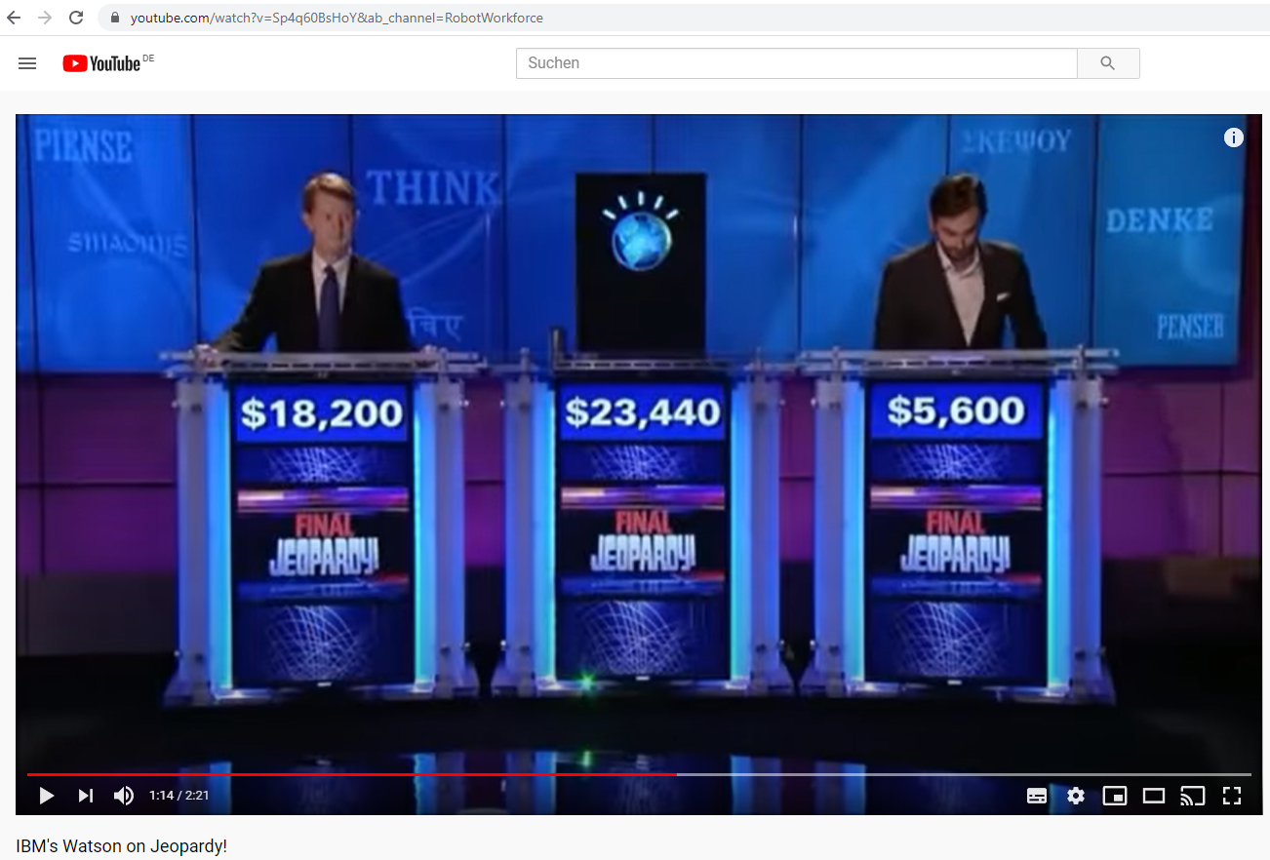
https://www.youtube.com/watch?v=Sp4q60BsHoY

Slide 9
Challenges in NLP Examples
Paraphrase an input text
Translate text from one language into another
Answer questions about the contents of the text (or corpus)
Draw inferences and conclusions from the text (or corpus)
Liddy, E.D. 2001. Natural Language Processing. In Encyclopedia of Library and Information Science, 2nd Ed. NY. Marcel Decker, Inc.

Slide 10
Typical algorithms for
Responding to phrases (e.g. chat bot)
Discover topics and concepts a text describes
Summarizing texts (to different length)
Extracting relevant keywords from texts
Identify the sentiment of a text or phrase
…
…
Break up texts in tokens
Reduce words to the root / stem
https://algorithmia.com/blog/introduction-natural-language-processing-nlp

Slide 11
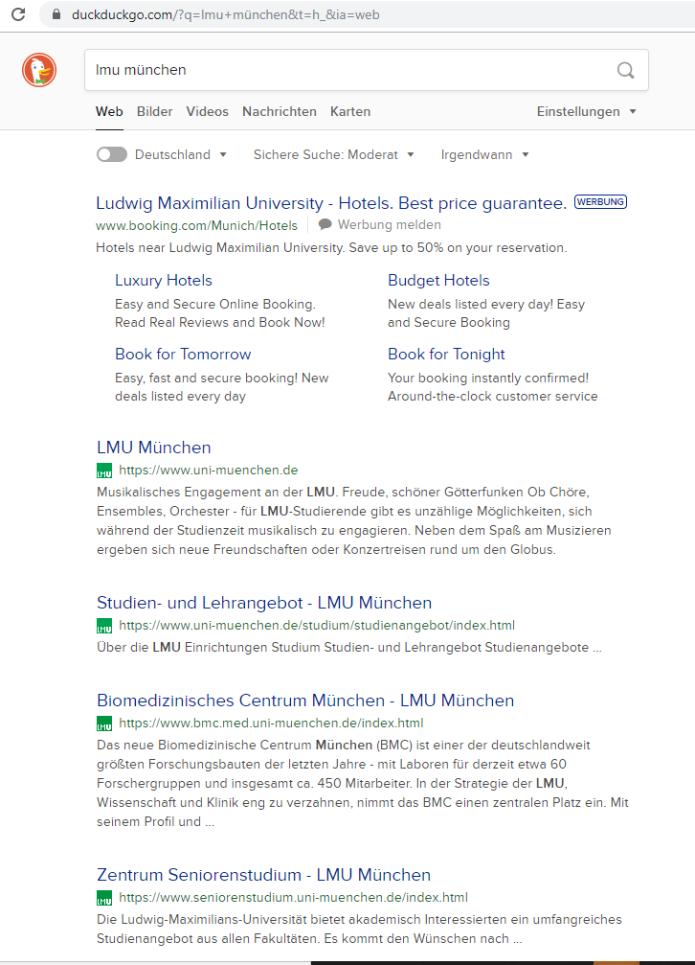

Slide 12
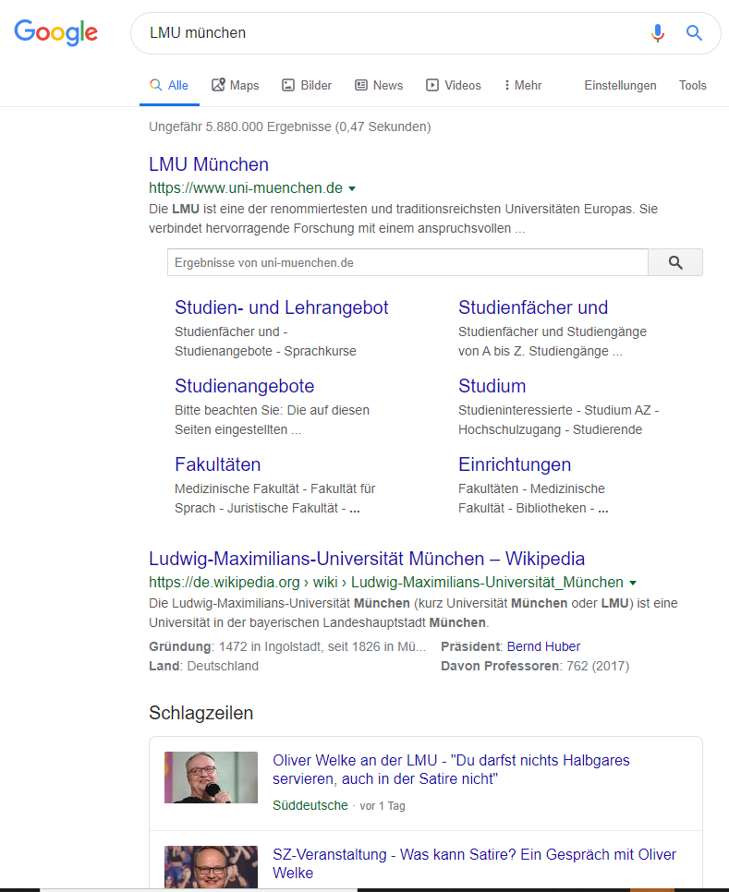

Slide 13
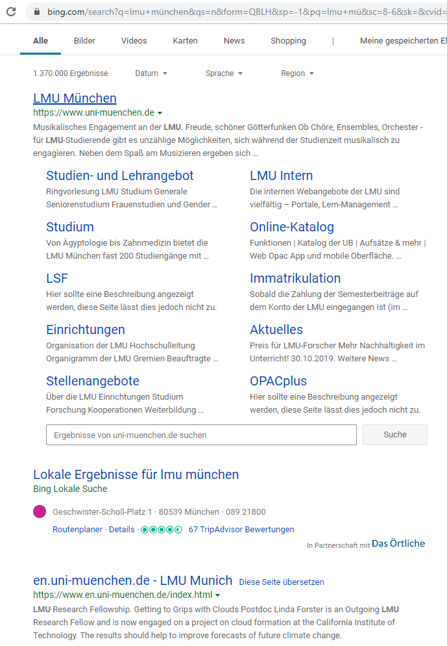
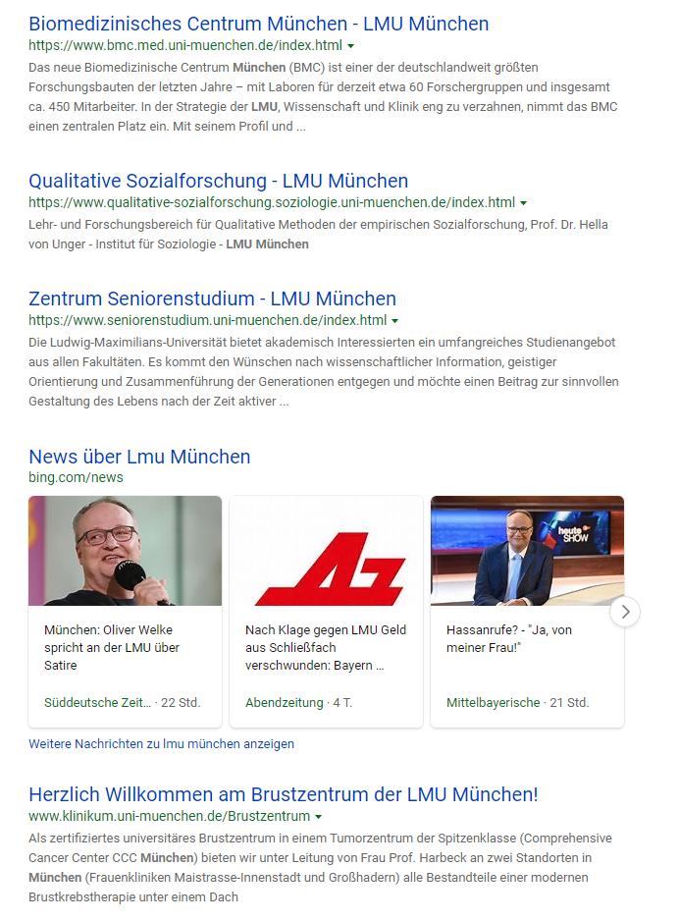

Slide 14
Discussion: Naive implementation of search
Given
10000 text documents with an average length of 1000 words
A search term of up to 4 words
Aim: the 10 text documents that best match the query
Approach?
Where can Machine Learning and AI help?
Scenario:
You have stored all articles of
the New York Times from 2010
to 2020
Someone asks for the article
about “Merkel visiting the US”
Which articles do you give back?

Slide 15
Python Example Counting word occurrences
Query = “media informatics”
Transfering the query into a coordinate
One cell / dimension for each word
Count occurances
informatics
media informatics
4
3
2
1
1
1
0 1 2 3 4
media
Example based on: https://livebook.manning.com/book/essential-natural-language-processing/chapter-1/55

Slide 16
Python Example Counting word occurrences
Query = “media informatics”
Transfering documents into coordinates
D1: media informatics media media media
D2: media informatics media informatics media informatics
Count occurances
media informatics
informatics
D1
4
1
4
3
2
1
D2
D2
3
3
D1
0 1 2 3 4
media
Example based on: https://livebook.manning.com/book/essential-natural-language-processing/chapter-1/55

Slide 17
Python Example Counting word occurrences
Query = “media informatics”
Transfering documents into coordinates
D1: media informatics media media media
D2: media informatics media informatics media informatics
Count occurances
media informatics
informatics
D1
4
1
4
3
2
1
D2
D2
3
3
Q
D1
0 1 2 3 4
media
Example based on: https://livebook.manning.com/book/essential-natural-language-processing/chapter-1/55

Slide 18
Python Example Counting word occurrences
d1 = "media ... informatics media ... media ... media"
d2 = "media informatics ... media ... informatics ... media informatics"
...
vector = [0, 0]
for word in d1.split(" "):
if word=="media":
vector[0] = vector[0] + 1
if word=="informatics":
vector[1] = vector[1] + 1
print (vector)
Example based on: https://livebook.manning.com/book/essential-natural-language-processing/chapter-1/55

Slide 19
Overview - NLP
Definition and Motivation
Applications
Terms, basic concepts and algorithms
Milestones in the history of NLP
Text Analytics

Slide 20
Application of NLP?
Where do you use NLP on a daily basis?
What are typical tasks?

Slide 21
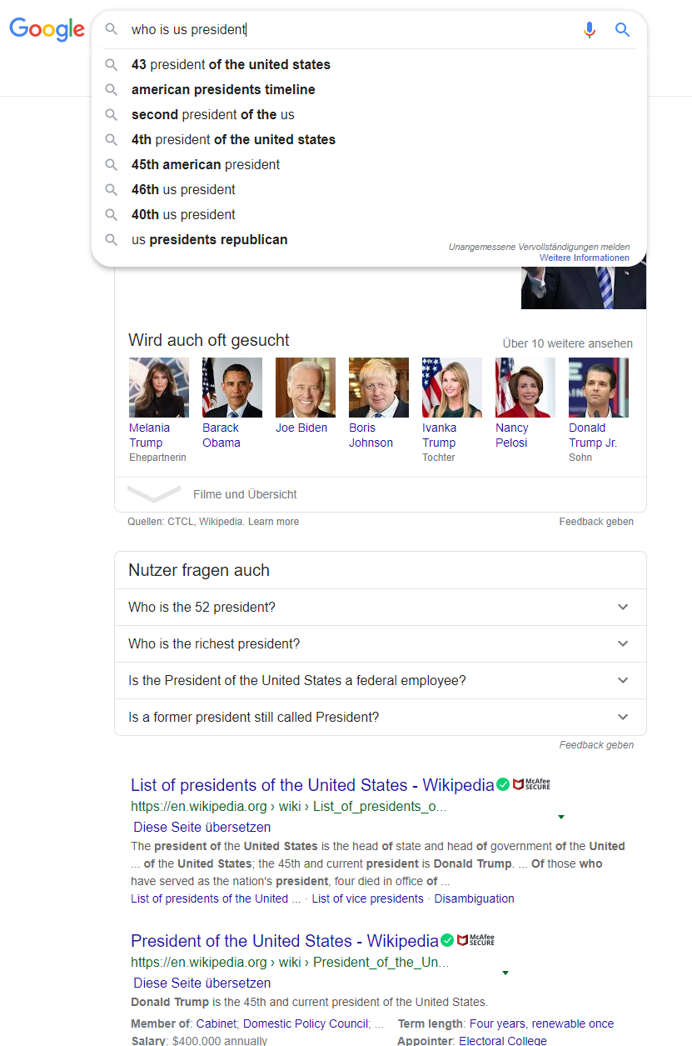
Application of NLP?
Where do you use NLP on a daily basis?
What are typical tasks?

Slide 22
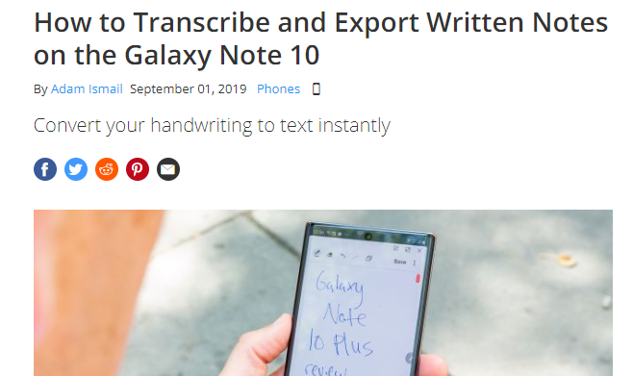
Application of NLP?
Where do you use NLP on a daily basis?
What are typical tasks?
https://www.tomsguide.com/how-to/how-to-transcribe-and-export-written-notes-on-the-galaxy-note-10
Notes:
https://www.tomsguide.com/how-to/how-to-transcribe-and-export-written-notes-on-the-galaxy-note-10

Slide 23
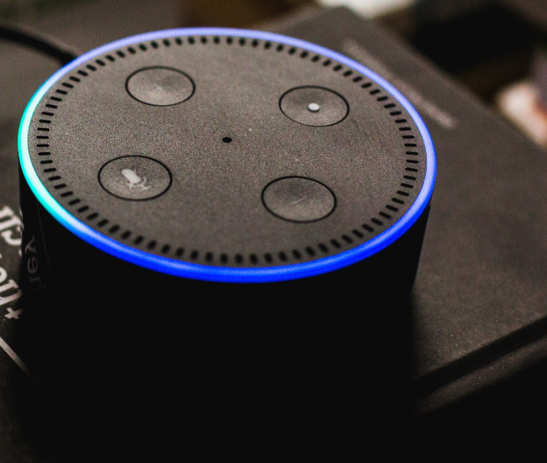
Application of NLP?
Where do you use NLP on a daily basis?
What are typical tasks?
Notes:
https://www.pexels.com/photo/alexa-alexa-talking-amazon-cortana-717235/

Slide 24
Overview - NLP
Definition and Motivation
Applications
Terms, basic concepts and algorithms
Milestones in the history of NLP
Text Analytics

Slide 25
Tokenization
Separating a text into individual words
Words are called tokens
Removing punctuation, (multiple) spaces, separators
Approach:
Search along the text and extract tokens separated by space and punctuation
Store all tokens in a list
Any difficulties?

Slide 26
Tokenization
Separating a text into individual words
Words are called tokens
Removing punctuation, (multiple) spaces, separators
Approach:
Search along the text and extract tokens separated by space and punctuation
Store all tokens in a list
Any difficulties? Dr. Max von Mayer-Hauser is today in New York and we will meet him-hopefully.

Slide 27
Stop Words Removal
Remove „small“ words in the text, such as articles, pronouns, and prepositions
Examples
English: the, and, a, to, …
German: der, die, das, und, es, …
Approaches include stop word lists or stop word learning (based on frequency)
Discussion: Approach based on ML/AI?

Slide 28
Text Normalization
Aim: match the “same” words
Syntactic matching
What is the problem? How to do this?

Slide 29
Text Normalization
Aim: match the “same” words
Upper case / lower case letters (e.g. all lower case)
Tricky if upper case is required to detect names, grammar
Normalizing word forms (stemming, lemmatization)
Acronyms (U.K. → UK)
Umlauts (für → fuer or fuer → für)
Dealing with numbers and symbols in text
Correcting misspelling

Slide 30
Stemming
Reducing the word to its stem
Extract the morphological root
removing affixes and suffixes
Heuristic process (works most of the time)
Approaches and algorithms
Set of rules (language dependent)
E.g. as automaton
Typical algorithms: Porter Stemmer, Snowball Stemmer
Example:
player, playing, playful, plays, played → play
newer, newest → new … what happens to news

Slide 31
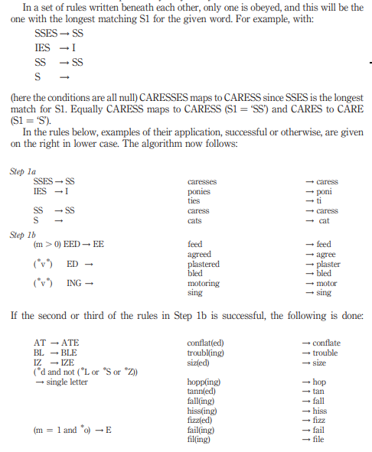
Example Porter Stemmer
Set of rules for removing/changing suffixes
Rules are grouped
Rules for their application of the rules
Porter, Martin F (1980) "An algorithm for suffix stripping." Program, 14(3)
Reprinted 2006: https://cl.lingfil.uu.se/~marie/undervisning/textanalys16/porter.pdf

Slide 32
Lemmatization
Return the base (dictionary) form of a word
Uses linguistic knowledge (vocabulary, grammar, morphological analysis)
“Lemmatization, unlike Stemming, reduces the inflected words properly ensuring that the root word belongs to the language. In Lemmatization root word is called Lemma. A lemma (plural lemmas or lemmata) is the canonical form, dictionary form, or citation form of a set of words.” https://www.datacamp.com/community/tutorials/stemming-lemmatization-python
Examples: was→be, running→run, has→have, swims→swim, caring→care, …

Slide 33
Stemming/Lemmatization based on ML? How would you do this?

Slide 34
Part-Of-Speech Tagging
Determining the type of a word in the context of a sentence
Identifying words as nouns, verbs, adjectives, adverbs, …

Slide 35
Named-Entity Disambiguation and Entity linking
Determining the meaning of a word, if word have more meanings
Using context and knowledge
Example
I did not use an apple to make these slides.
vs.
I really like to bake apple crumple.

Slide 36
Named-Entity Recognition
Gets entities from unstructured texts
Assigning entities/words to categories
Examples of named entities: people, places, companies, organizations, industries, products, product categories, time, location, brands, etc.
Application and domain specific, e.g. abbreviations for trading stocks, medical conditions, addresses
Library: https://spacy.io/api/annotation#section-named-entities
Example in Python: https://nlpforhackers.io/named-entity-extraction/
Software: Stanford Named Entity Recognizer (NER) https://nlp.stanford.edu/software/CRF-NER.shtml

Slide 37
Bag of Words
Texts are considered a set of words
Simplified representation
Ignores grammar (and generally word order)
Typical calculation:
Frequency of occurrence of words
Frequency of n-grams (preserves some word order)
“My cat likes to sleep. I sleep a lot. Do you have a cat?”
cat 3x, sleep 2x, a 2x, …

Slide 38
Corpus, Corpora
Monolingual corpora
data from one single language
Parallel corpora
original texts in one language
translations in other languages
Examples:
Gutenberg, archive of free electronic books, https://www.gutenberg.org/ or https://www.projekt-gutenberg.org/
https://www.collinsdictionary.com/api/collins-english-dictionary,61,HCA.html

Slide 39
Corpus
“A corpus is a large body of natural language text used for accumulating statistics on natural language text. The plural is corpora. Corpora often include extra information such as a tag for each word indicating its part-of-speech, and perhaps the parse tree for each sentence.” NLP Dictionary http://www.cse.unsw.edu.au/~billw/nlpdict.html
Further Examples:
Swiss SMS Corpus, https://sms.linguistik.uzh.ch/
The National University of Singapore SMS Corpus https://www.kaggle.com/rtatman/the-national-university-of-singapore-sms-corpus

Slide 40
Live-Coding

Slide 41
Overview - NLP
Definition and Motivation
Applications
Terms, basic concepts and algorithms
Milestones in the history of NLP
Text Analytics

