Slide 1
Optimization-based keyboard design

Slide 2
Learning Goals
Combinatorial optimization as a UI design approach
Components of optimization
Example optimizer and application results
Intelligent Text Entry

Slide 3
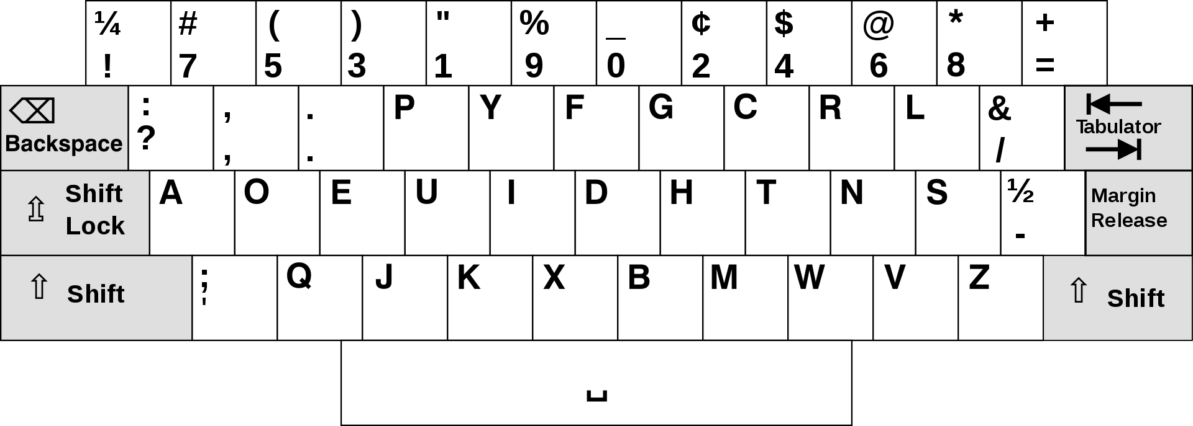
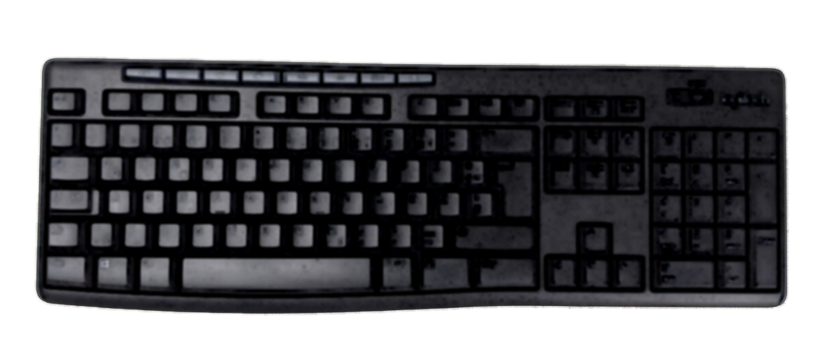
Motivation: Fast typing without errors
Are some layouts better than others?
If so, how do we find the best one?
QWERTY, by Christopher Sholes, 1873
Dvorak, by August Dvorak, 1936
By: https://commons.wikimedia.org/wiki/File:KB_United_States.svg, https://commons.wikimedia.org/wiki/File:KB_United_States_Dvorak.svg
Intelligent Text Entry

Slide 4
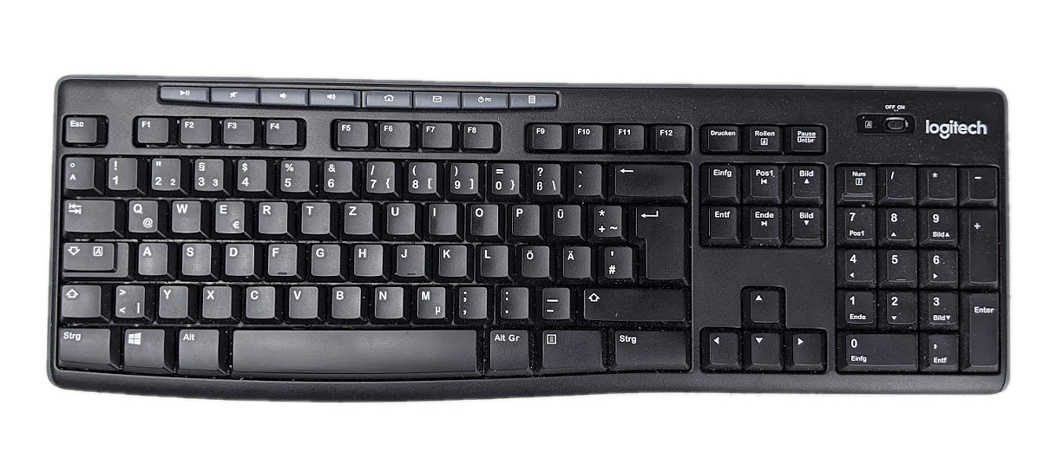
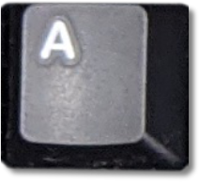
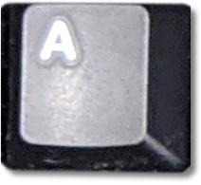
Key Assignment Problem
?
…
How many layouts are there?
26! = 4 * 10²⁶
For comparison - stars in the universe: https://www.esa.int/Science_Exploration/Space_Science/Herschel/How_many_stars_are_there_in_the_Universe
Intelligent Text Entry

Slide 5
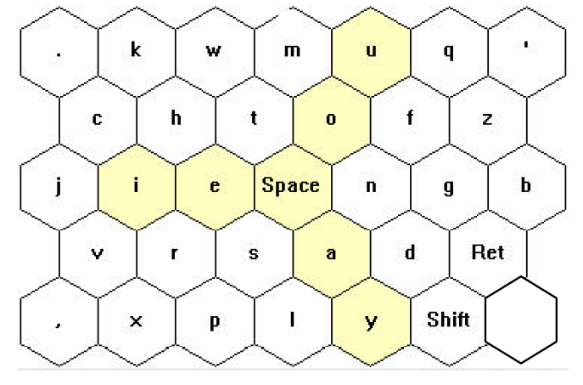
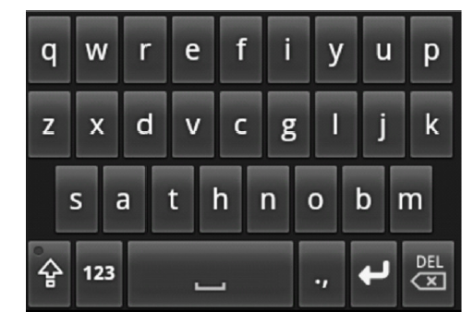
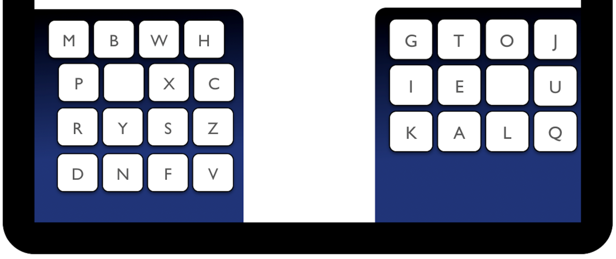
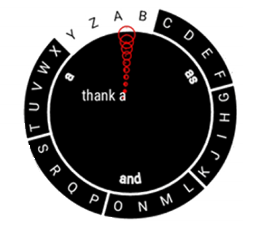
Examples of Optimised Designs
Zhai et al. 2000, Dunlop and Levine 2012, Oulasvirta et al. 2013, Gong et al. 2018
Intelligent Text Entry

Slide 6
What is „optimal“?

Design space: Best among which options?
Design objective: Best for what?
Optimizer: How to find the best design? Best with which guarantees?


Intelligent Text Entry

Slide 7
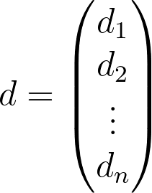
Design Space, formalised
Design space D with n design variables
Intelligent Text Entry

Slide 8
Design Space: Set of possible layouts
?
26! = 4 * 10²⁶
Intelligent Text Entry

Slide 9
Objective Function: How to judge a layout?
Intelligent Text Entry

Slide 10
Objective Function: How to judge a layout?
Finger movement time (e.g. Fitts‘ law)
Language properties (e.g. bigram frequencies)
k₁
k₂
e.g.
Combined: mean time between two key presses
Intelligent Text Entry

Slide 11
Optimizer: How to pick layouts?
Intelligent Text Entry

Slide 12
Design Task
e.g. keyboard layout optimization
Intelligent Text Entry

Slide 13
A Simple Optimizer
Can you think of a trivial optimizer?
Random Search:
Generate random design
Keep if better than current best design
Repeat
Intelligent Text Entry

Slide 14
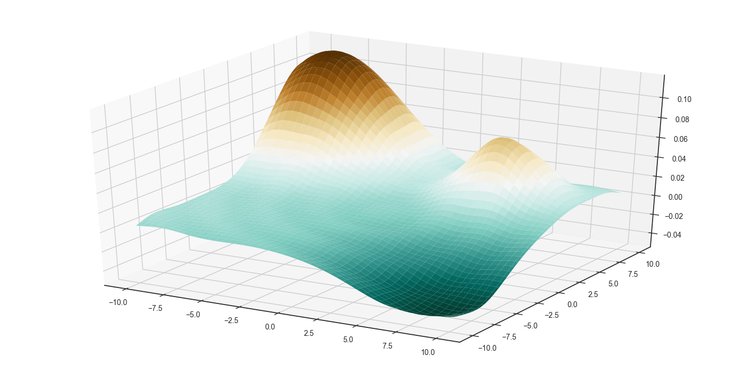
Optimization Landscape
Here: objective function (y) across two design parameters (x, z)
global maximum
local maximum
y
z
x
global minimum
Intelligent Text Entry

Slide 15
Random Guessing
Intelligent Text Entry

Slide 16
Optimizers
Heuristic methods (e.g. Simulated Annealing)
 Flexible
 Not guaranteed to find global optimum
Exact methods (e.g. Integer Programming)
 Guarantees
 Less flexible objectives
Intelligent Text Entry

Slide 17
Example: Simulated Annealing
Metaphor: shaping hot metal
Flexible at beginning (exploration)
Gradually more rigid as it “cools down” (exploitation)
Photo by Kateryna Babaieva
For i=0 to N:
reduce temperature T
generate neighbor design
if better: go to neighbor
else: still go with chance relative to T
Intelligent Text Entry

Slide 18
Simulated Annealing
Intelligent Text Entry

Slide 19
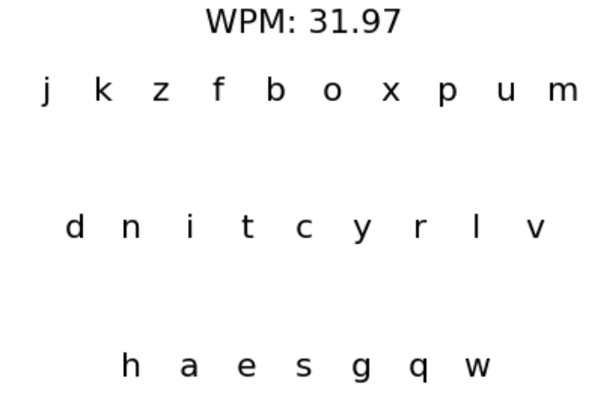
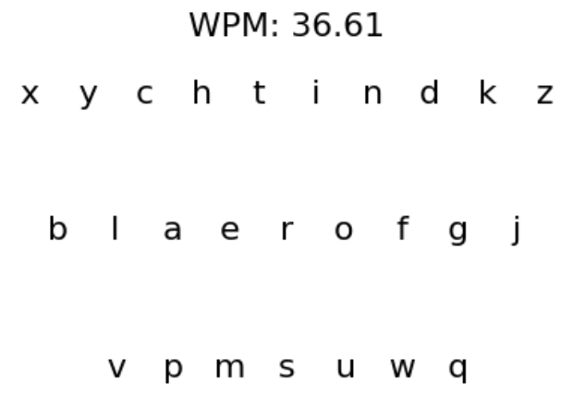
Example Results
“boxpum”
found with random search
“aero”
found with Simulated Annealing
Challenge – can you find a better layout than “aero”? Use the provided python notebook as a starting point.
Intelligent Text Entry

Slide 20
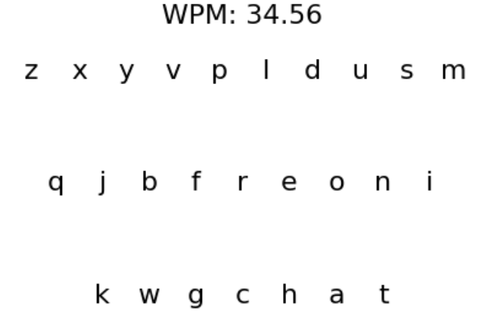
Example Results
With a modified objective function
“chat”
found with Simulated Annealing
What was this layout optimized for?
→ Typing with right thumb, reduce thumb stretching
Intelligent Text Entry

Slide 21
Potential of Optimization-based Design
Obtaining information on the design problem and a formal specification
Exploring a large design space comprehensively
Improving quality and robustness of designs
Estimating possible improvements
Supporting human designers
Optimization during use, personalised UIs
Requires: Models of user behaviour, formal problem definition / objective function, computational capacity, …
Intelligent Text Entry

Slide 22
Questions & Discussion
Name and explain the key components of optimization-based UI design.
How can designers influence obtained designs in this approach?
Explain Simulated Annealing. Can you consider a design resulting from this method as „optimal“? Why (not)?
If it is possible to find better designs than QWERTY, why are we not using them widely?
Beyond keyboard layouts, which other UI design problems could be addressed with this approach? And which are hard to address in this way?
Intelligent Text Entry

Slide 23
References
Dunlop, M., & Levine, J. (2012). Multidimensional pareto optimization of touchscreen keyboards for speed, familiarity and improved spell checking. Proceedings of the SIGCHI Conference on Human Factors in Computing Systems, 2669–2678. https://doi.org/10.1145/2207676.2208659
Gong, J., Xu, Z., Guo, Q., Seyed, T., Chen, X. „Anthony“, Bi, X., & Yang, X.-D. (2018). WrisText: One-handed Text Entry on Smartwatch using Wrist Gestures. Proceedings of the 2018 CHI Conference on Human Factors in Computing Systems - CHI ’18, 1–14. https://doi.org/10.1145/3173574.3173755
Oulasvirta, A., Reichel, A., Li, W., Zhang, Y., Bachynskyi, M., Vertanen, K., & Kristensson, P. O. (2013). Improving two-thumb text entry on touchscreen devices. Proceedings of the SIGCHI Conference on Human Factors in Computing Systems, 2765–2774. https://doi.org/10.1145/2470654.2481383
Zhai, S., Hunter, M., & Smith, B. A. (2000). The metropolis keyboard—An exploration of quantitative techniques for virtual keyboard design. Proceedings of the 13th Annual ACM Symposium on User Interface Software and Technology - UIST ’00, 119–128. https://doi.org/10.1145/354401.354424
Further Reading:
Oulasvirta, A., Dayama, N. R., Shiripour, M., John, M., & Karrenbauer, A. (2020). Combinatorial Optimization of Graphical User Interface Designs. Proceedings of the IEEE, 108(3), 434–464. https://doi.org/10.1109/JPROC.2020.2969687
Simon, H. A. (1969). The sciences of the artificial. The MIT Press.
Intelligent Text Entry

Slide 24
License
This file is licensed under the Creative Commons Attribution-Share Alike 4.0 (CC BY-SA) license:
https://creativecommons.org/licenses/by-sa/4.0
Attribution: Daniel Buschek
For more content see: https://iui-lecture.org

