Slide 1


Introduction to Intelligent User Interfaces
Introduction and Motivation

Slide 2





Team
Albrecht Schmidt
Andreas Butz
Sven Mayer
Luke Haliburton
Jesse Grootjen
Introduction and Motivation

Slide 3

Information Regarding Corona
The „3G“ rule applies in university buildings (while the incidence is higher than 35)
Certificate is controlled at entrances
Testing possibility for students: www.schnelltest-lmu.de
Medical facemasks are required indoor
Exams
„3G“ rule does not apply for exams
Masks can be taken off during exams while seated (because the safety
distance of 1.5m is maintained)
Similarly, the presenter can take off masks while maintaining the 1.5m distance.
As regulations change frequently, check the LMU website to stay up to date
Organization

Slide 4
Organization
Lecture: Thursday 12-14 c.t.,
  Geschw.-Scholl-Pl. 1 (M), M 101
  https://lmu-munich.zoom.us/j/95176165936?pwd=RHB2Q3hiRjMxQ0FvZTZqWmJBQzJUUT09
Tutorials: Monday 16-18 c.t.,
  Amalienstr. 73A, Room: 220
  Zoom TBA
Live sessions will not be recorded
Practical projects: one (iteration of a) practical project over the course of the lecture; intermediate presentations in the tutorials and final presentation at the end of the lecture
Organization

Slide 5
News
Uni2Work course https://uni2work.ifi.lmu.de/course/W21/IfI/IUI
Website http://www.medien.ifi.lmu.de/lehre/ws2122/iui/
Organization

Slide 6
Exam
The exam will consist of two parts
Your practical project including the final presentation (1/2 of the final grade)
An oral exam of ~10 minutes about the content of the lectures and exercises (1/2 of the final grade)
This lecture has 6 ETCS which is equivalent to 180h of work
Organization

Slide 7
Lectures
Date | Location | Topic | Recording for this Topic
21.10. | In person | Introduction to Intelligent User Interfaces
28.10. | In person | Discussion Artificial Intelligence | Lecture 02
11.11. | In person | Discussion Deceptive User Interfaces & Voice UI | Lecture 03, Lecture 04
25.11. | In person | Discussion Intelligent Text Entry | Lecture 05
02.12. | In person | Discussion Text and Natural Language Processing | Lecture 06
09.12. | In person | Discussion Context Awareness Interaction in Smart Environments | Lecture 07
20.01. | In person | Discussion Recommender Systems | Lecture 08, Lecture 09, Lecture 10, Lecture 11
03.02. | In person | Discussion Explainable AI, Bias and Ethics, and Q&A | Lecture 12, Lecture 13
10.02. | In person | Final Presentations (10+5) | Lecture 14
Organization

Slide 8
Tutorials
Oct 25 Organization, Live Coding Session: Introduction to Python and ML
Nov 01 Live Coding Session + Q&A
Nov 08 Live Coding Session
Nov 15 Project Ideation + Q&A
Nov 22 1min Project Pitches + Live Coding Session
Nov 29 Live Coding Session + Individual Help for Projects if Needed
Dec 06 3min Project Pitches: Show Current Project Status
Dec 13 Live Coding Session + Individual Help for Projects if Needed
Jan 10 5min Project Report: Show Current Project Status
Jan 17 Individual Help for Projects if Needed
Jan 24 Introduction to Giving Great Project Presentations, Individual Help for Projects
Jan 31 Individual Help for Projects if Needed
Feb 07 Q&A: Exam preparation
Projects
Organization

Slide 9
Introduction and Motivation

Slide 10
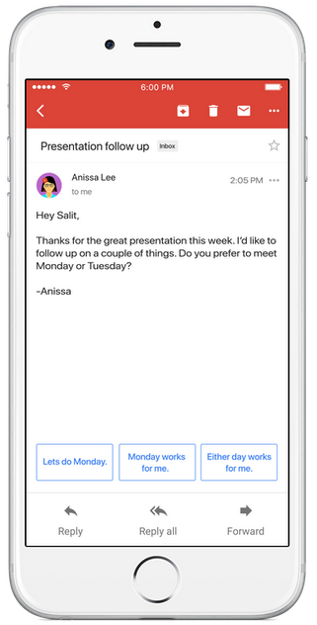
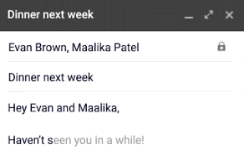

Text Suggestions
Google‘s Smart Reply & Smart Compose
Language model,
given email text
https://blog.google/products/gmail/save-time-with-smart-reply-in-gmail/
https://ai.googleblog.com/2018/05/smart-compose-using-neural-networks-to.html
Introduction and Motivation

Slide 11
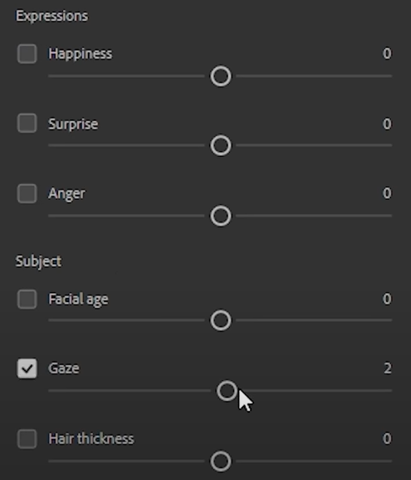
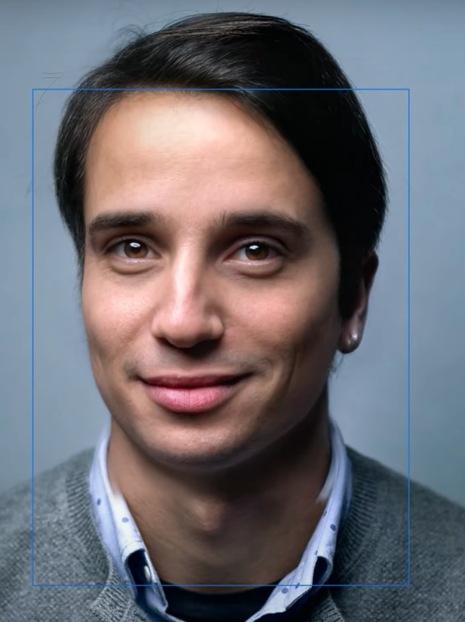
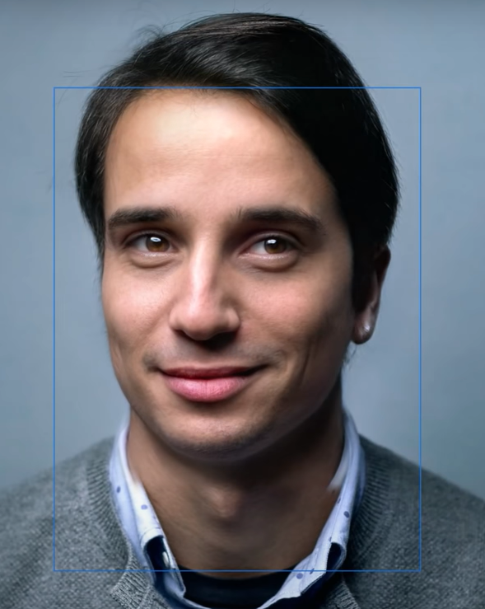
Semantic Image Manipulation
„Smart Portrait Filters“ in Adobe‘s Photoshop
Generative model,
learned from many portraits
https://blog.adobe.com/en/2020/10/20/photoshop-the-worlds-most-advanced-ai-application-for-creatives.html https://blogs.nvidia.com/blog/2020/10/20/adobe-max-ai/, https://github.com/NVlabs/stylegan2
Introduction and Motivation

Slide 12
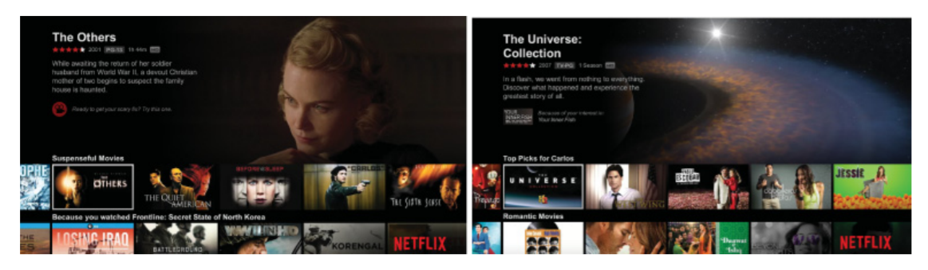





Recommender Systems
How do recommender systems impact the user experience?
Carlos A. Gomez-Uribe and Neil Hunt. 2015. The Netflix Recommender System: Algorithms, Business Value, and Innovation. ACM Trans. Manage. Inf. Syst. 6, 4, Article 13 (December 2015), 19 pages. DOI: https://doi.org/10.1145/2843948
Why are recommender systems used?
How do recommender work?
What data do recommender systems require?
Introduction and Motivation
Notes:
OK

Slide 13
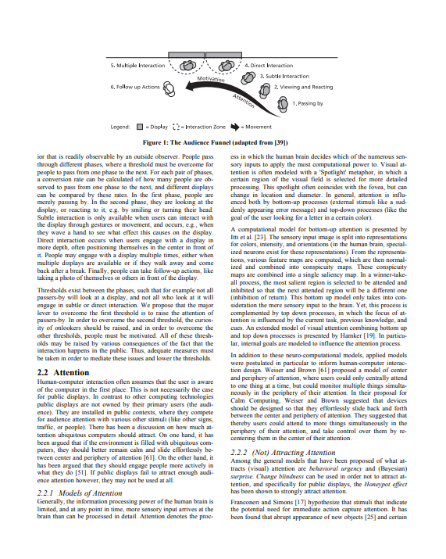
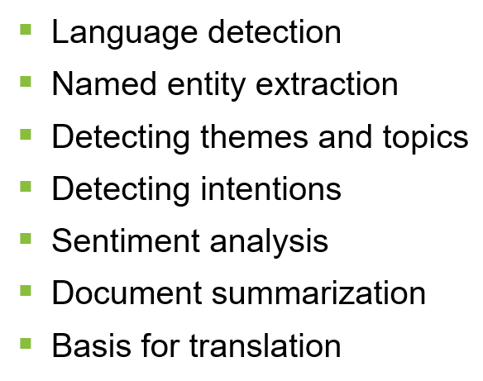
Text analytics
Where can we use it and how can it improve interaction?
Answering questions like
  What is this text about?
  What did the person communicate?
  What is the key information in this document?
  What feelings are communicated?
  Is this different from what was said before?
Application areas
  Social media analytics, e.g. twitter
  Communication and reading interfaces
  Customer reviews and feedback
  Chat bots
  Text Forensics
http://www.medien.ifi.lmu.de/pubdb/publications/pub/mueller2010mm/mueller2010mm.pdf
Introduction and Motivation
Notes:
http://www.medien.ifi.lmu.de/pubdb/publications/pub/mueller2010mm/mueller2010mm.pdf

Slide 14
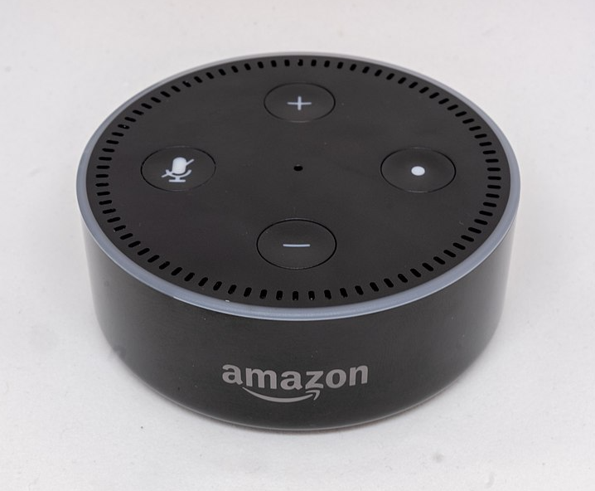
VUI design process
How to design a dialog structure?
Think of alternatives
  structure
  wording
Try out your dialog
  wizard of Oz technique!
  use outside people
Refine, Revise, Repeat
Image by Gregory Varnum, CC BY-SA 4.0 via Wikimedia Commons
https://commons.wikimedia.org/wiki/File:Amazon_Echo_Dot_-_June_2018_(1952).jpg
Introduction and Motivation
Notes:
https://de.m.wikipedia.org/wiki/Datei:Amazon_Echo_Dot_-_June_2018_(1952).jpg

Slide 15
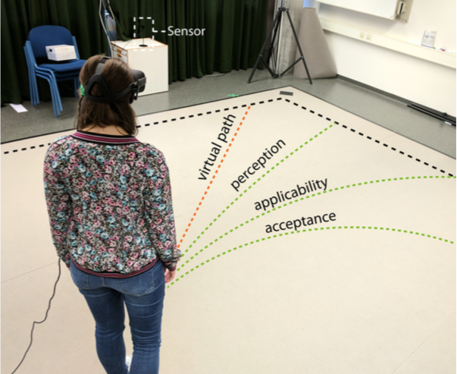
A Deceptive UI: redirected Walking
What is real in an intelligent UI?
M. Rietzler, J. Gugenheimer, T. Hirzle, M. Deubzer, E. Langbehn and E. Rukzio, "Rethinking Redirected Walking: On the Use of Curvature Gains Beyond Perceptual Limitations and Revisiting Bending Gains," 2018 IEEE International Symposium on Mixed and Augmented Reality (ISMAR), Munich, Germany, 2018, pp. 115-122, doi: 10.1109/ISMAR.2018.00041.
Image from https://ieeexplore.ieee.org/abstract/document/8613757
Introduction and Motivation

Slide 16


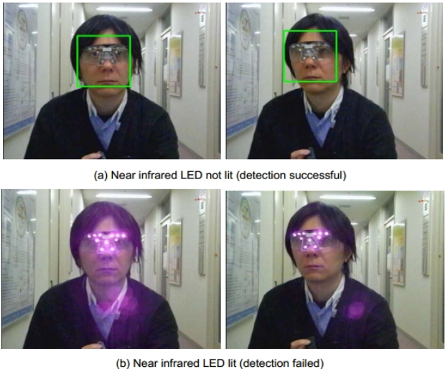
Facial Recognition
Convenient biometric or overly powerful?
Unlock your phone
  Hands-free identification
  What are the major issues?
Surveillance
  Privacy
  Tricks to „hide“ from facial recognition technology
https://www.bbc.com/news/uk-51237665
http://research.nii.ac.jp/~iechizen/official/research-e.html#research2c
Introduction and Motivation
Notes:
https://pxhere.com/en/photo/1620437

Slide 17
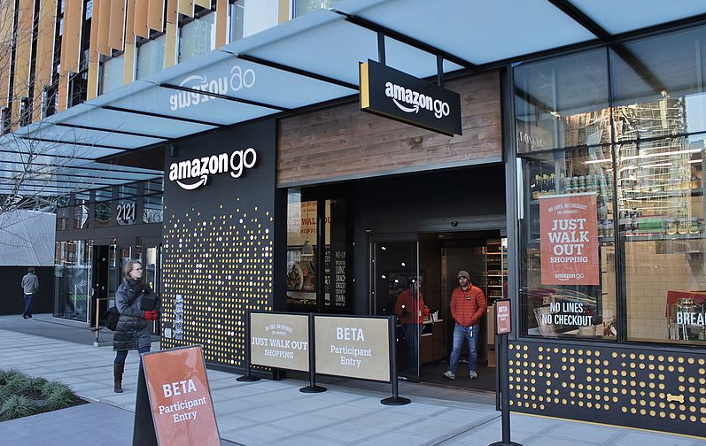
HCI Replacing HHI in Stores
„Just Walk Out“ shopping experience at Amazon Go
Surveillance-powered shopping
  Does not use facial recognition
How does it work?
  Is it „intelligent“? How so?
Image by SounderBruce, CC BY-SA 4.0 via Wikimedia Commons
https://commons.wikimedia.org/wiki/File:Amazon_Go_in_Seattle,_December_2016.jpg
Introduction and Motivation

Slide 18



AI Recruiting
Is an AI a “fairer“ recruiter?
Introduction and Motivation
Notes:
https://pixabay.com/illustrations/word-cloud-recruitment-process-1758159/
https://pxhere.com/de/photo/1446003
Visualisation created ourselves using free-to-use images from Pexels and Unsplash

Slide 19
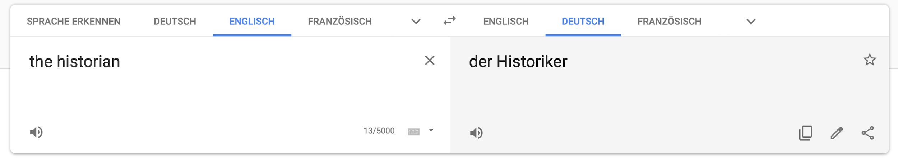

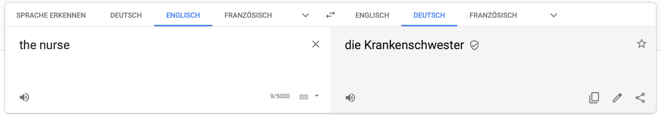
Natural Language Translation
Female historians and male nurses do not exist?
https://translate.google.com
https://algorithmwatch.org/en/story/google-translate-gender-bias/
Introduction and Motivation

Slide 20
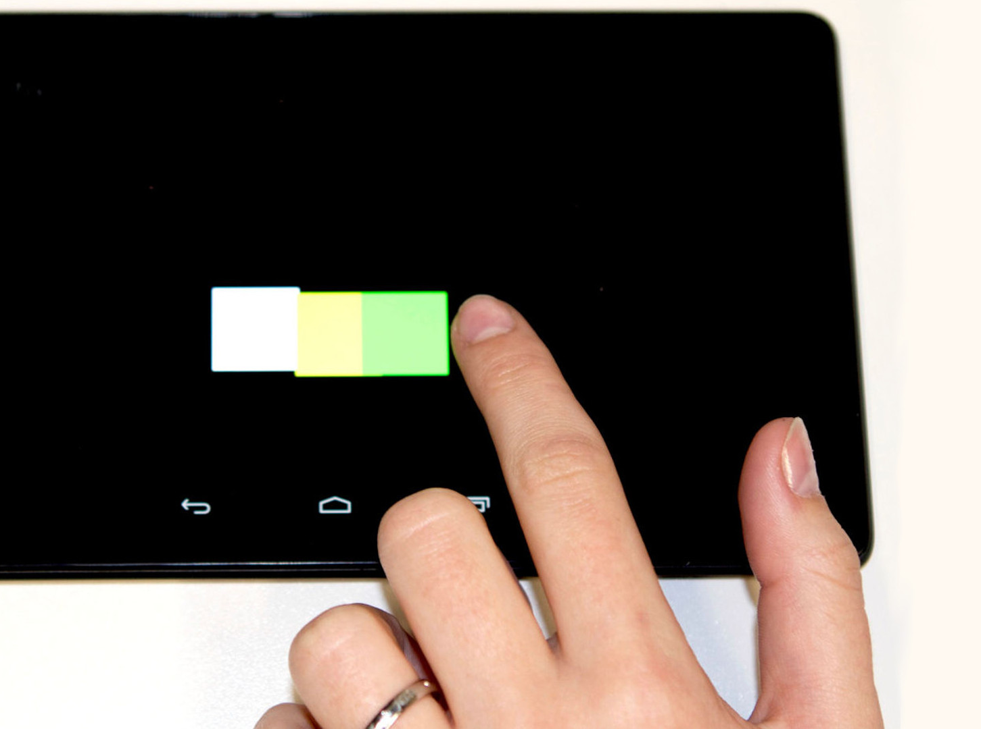
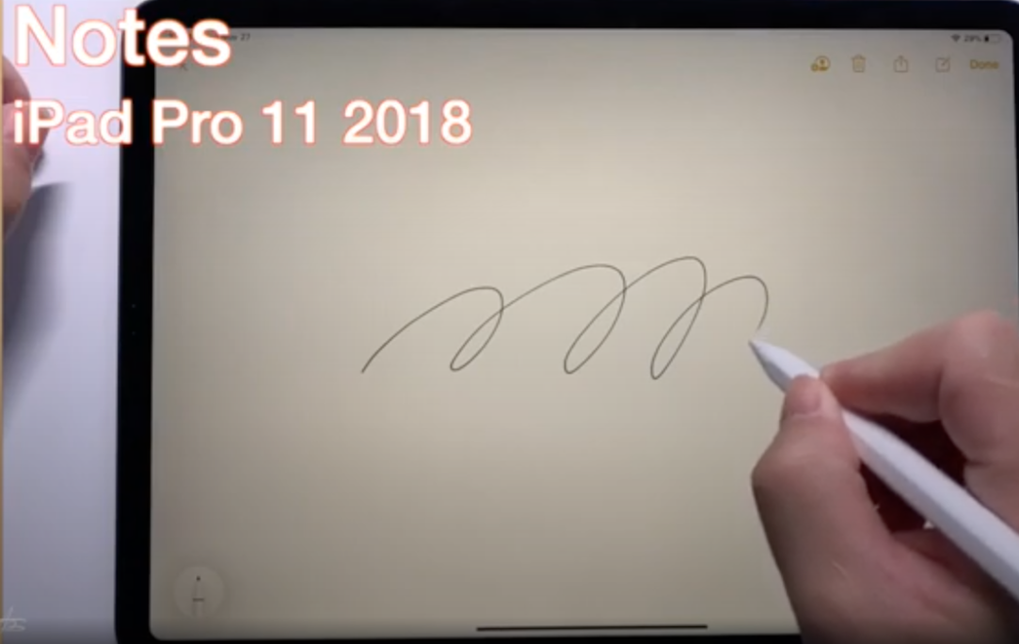
Intelligent Touch
Why are we so precise with our fingers on a screen?
Nexus 7 2013
Henze, N., Mayer, S., Le, H.V. and Schwind, V. Improving software-reduced touchscreen latency. Proc. MobileHCI ’17 https://doi.org/10.1145/3098279.3122150
https://www.youtube.com/watch?v=l6Nz8wVUU74
Introduction and Motivation

Slide 21
Intelligence and Artificial Intelligence
HCI perspective

Slide 22
What is considered Artificial Intelligence?
What is AI?

Slide 23
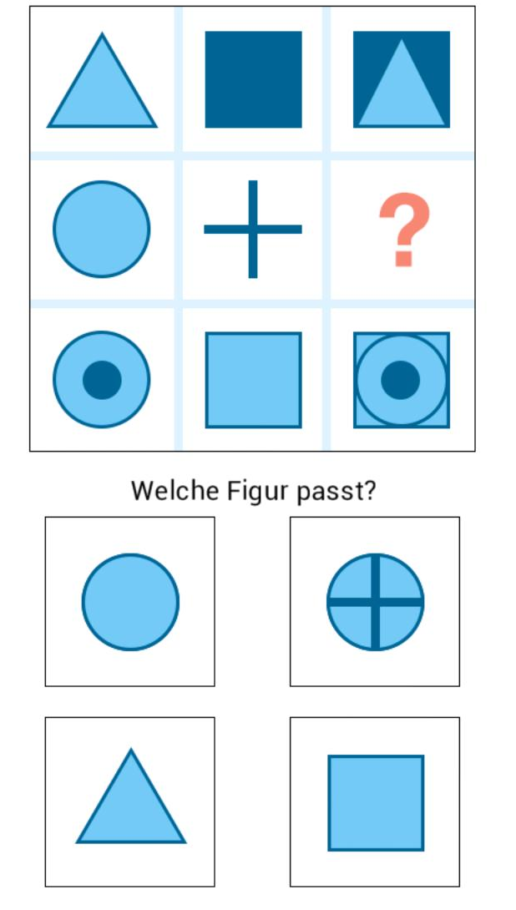
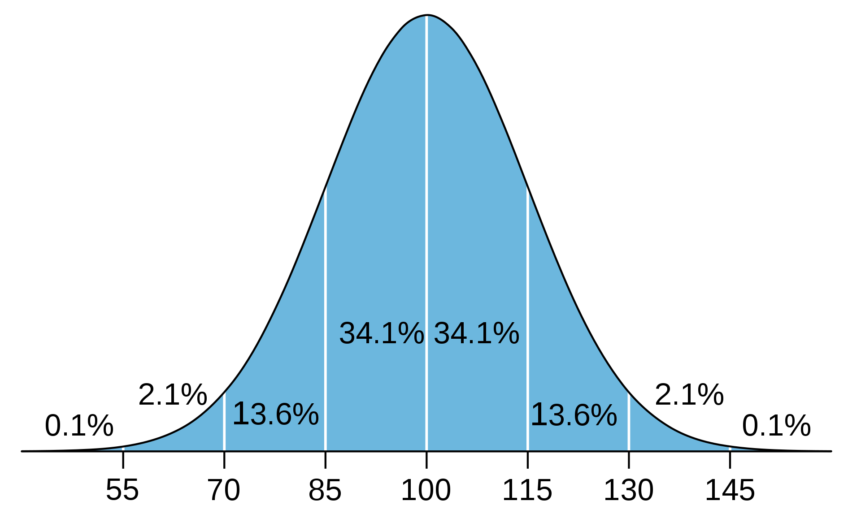
What is considered Artifical Intelligence?
What is Human Intelligence?
Which figure fits?
Notes:
What tasks are in an IQ test?
Why are the solution requiring an intelligent person/actor?
Predict the future from know examples 🡪 regresion, prediction
Classify based on previous examples 🡪 NN, SVM
The odd

Slide 24
What is in an IQ test?
Many different types… typical questions include:
Finding Analogies (math and verbal)
  Pen and writing, cup and ???
Finding / extending Pattern (graphical and math)
  45 … 40 … 60 … 55 … 75 … 70 … ???
Classification tasks
  Make two groups: apple, plate, grape, cake, spoon, knife
Making sense spatial and visual representations
Reasoning and logical
General knowedge
What is AI?

Slide 25
Goal:
Design Human-machine systems outperform humans as well as machines
Intuitive cooperation between humans and computers is the key challenge

Slide 26
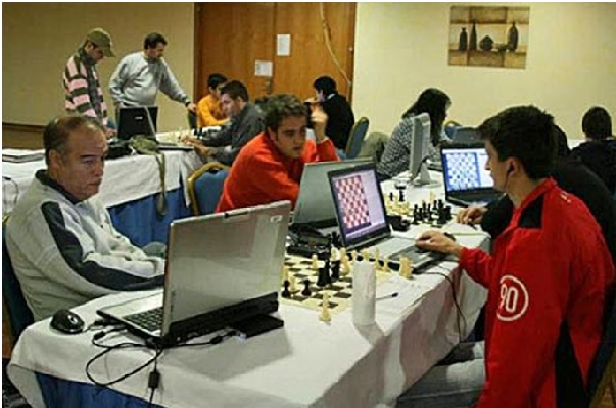
Cyborg chess - centaur chess' advanced chess - freestyle chess
People play and use computer assistance
… not sure about this in chess, however in open problems this is the way forward
https://labs.sogeti.com/decision-support-better-than-machine-intelligence/

Slide 27
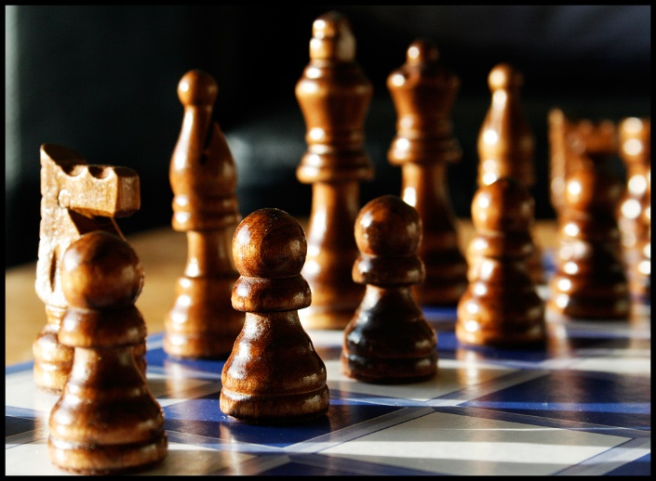
Who is more intelligent?
Who appears more intelligent?
Technologies make us (observable) intelligent!
https://www.flickr.com/photos/tenspeedphotography/3536942268
by Richard Heaven [CC BY 2.0]
Question
Human with
no Augmentation
Human with
Augmentation
Answer

Slide 28
Automation or Augmentation?
Who is in Control?

Slide 29
Augmenting – Amplifying Human Cognition
What cognitive and perceptual abilities can we enhance?
Where will cognitive and perceptual enhancement be hard?

Slide 30
Augmentation not automation… or towards amplification?
As We May Think by Vannevar Bush (Bush, 1945)
Joseph Lickider’s idea of a “Man-Computer Symbiosis” (Licklieder, 1960)
Douglas Engelbart’s research on “Augmenting [the] Human Intellect” (Engelbart, 1962)
Ubiquitous Computing as described by Mark Weiser (Weiser, 1992)
Augmented Cognition (DARPA)
Bush, V.,1945. As we may think. The Atlantic, July 1945, pp.101-108.
Licklider, J. C. R., 1960. Man-Computer Symbiosis. IRE Transactions on Human Factors in Electronics, HFE-1, March 1960, pp 4-11
Engelbart, D. C. 1962. Augmenting Human Intellect: A Conceptual Framework. SRI Summary Report AFOSR-3223. October 1962.
Weiser, M., 1991. The computer for the 21st century. Scientific American 265.3, pp94-104, 1991.
Notes:
Conceptually this work is strongly inspired by Joseph Lickider’s idea of a “Man-Computer Symbiosis” (Licklieder, 1960) and by Douglas Engelbart’s research on “Augmenting [the] Human Intellect” (Engelbart, 1962). These first and comprehensive explorations of how interactive computing technology can be used to amplify the human intellect have inspired many developments over the last 50 years. The idea of Ubiquitous Computing as described by Mark Weiser (Weiser, 1992) moved the vision forward to interactive computing technologies pervasively integrated with everyday environments. Our project aims to evaluate and update these concepts to create a new vision for the augmentation and amplification of human cognition and perception fitting technologies and information in the 21st century. Licklieder, Engelbart, and Weiser also inspired the methodology and in particular the experimental research approach to be taken, with a lab implementing the tools for everyday use of the researchers.
Augmented Cognition
DARPA has investigated the notion of augmented cognition from the perspective of cognition aware systems. In particular with an aim at military applications, they investigated how psychophysiological measurements can be used to assess the cognitive state of the user in real-time (John et al., 2004 and Schmorrow et al., 2006). The idea is to build cognitively aware systems that dynamically adapt to the human ability (Schmorrow et al., 2002). The term “augmented cognition” is also used by the Human Factors and Ergonomics Society (HFES, http://tg.hfes.org/actg/) for a technical working group on this topic in a very broad sense. In contrast, we will investigate constructive means for creating tools that amplify cognition and perception rather than measuring cognitive load. We aim at measuring how cognitive tools increase the performance of an individual.

Slide 31
Enhancing and amplifying perception and cognition
Theoretical motivation
  Extended mind and active externalization
  Distributed cognition
  Collaborative knowledge and group cognition
  Use of space and external representations
Technology push
  Superior sensing and capture systems
  Advances in AI, processing, and communication
  Devices for embedded presentation and augmented reality
Hollan, J., Hutchins, E. and Kirsh, D., 2000. Distributed cognition: toward a new foundation for human-computer interaction research. ACM Transactions on Computer-Human Interaction (TOCHI), 7(2), pp.174-196.
Clark, A. and Chalmers, D., 1998. The extended mind. analysis, 58(1), pp.7-19.
Kirsh, D., 2010. Thinking with external representations. Ai & Society, 25(4), pp.441-454.
Stahl, G., 2006. Group Cognition: Computer Support for Building Collaborative Knowledge (Acting with Technology).
Notes:
http://consc.net/papers/extended.html

Slide 32
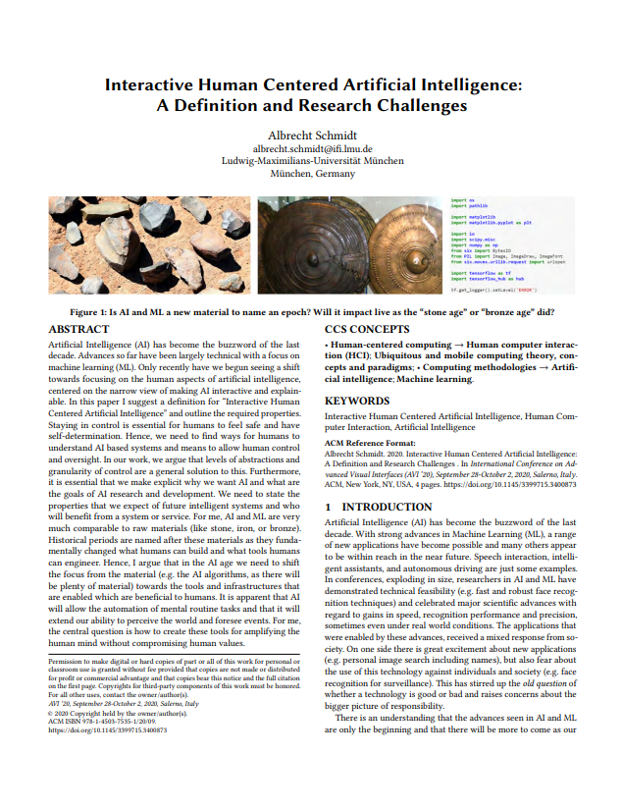
Definition
An Interactive Human Centered Artificial Intelligence is an Artificial Intelligence that enables interactive exploration and manipulation in real time and is designed with a clear purpose for human benefit while being transparent about who has control over data and algorithms.
https://uni.ubicomp.net/as/iHCAI2020.pdf

Slide 33
Properties (1/2)
Interactive Human Centered Artificial Intelligence
Individuals can interact in real time with the algorithms, models, and data and can manipulate and control all relevant parameters.
The impact of changes and manipulations made by the user can be observed in real time.
In fast processes the speed can be reduced to allow interactions, interventions, and manipulation.
Individuals can interactively explore why and how specific decisions are made and find out how changes in the parameters, data, and models impact outcomes.

Slide 34
Properties (2/2)
Interactive Human Centered Artificial Intelligence
It states how humans can benefit from the artificial intelligence.
It explains what risks the artificial intelligence poses for individuals as well as on societal level.
It is visible who has control of the artificial intelligence, in particular who has the power over data, models, and algorithms.
It is visible what data, knowledge base, and information is used or has been used to create and inform the artificial intelligence.

Slide 35
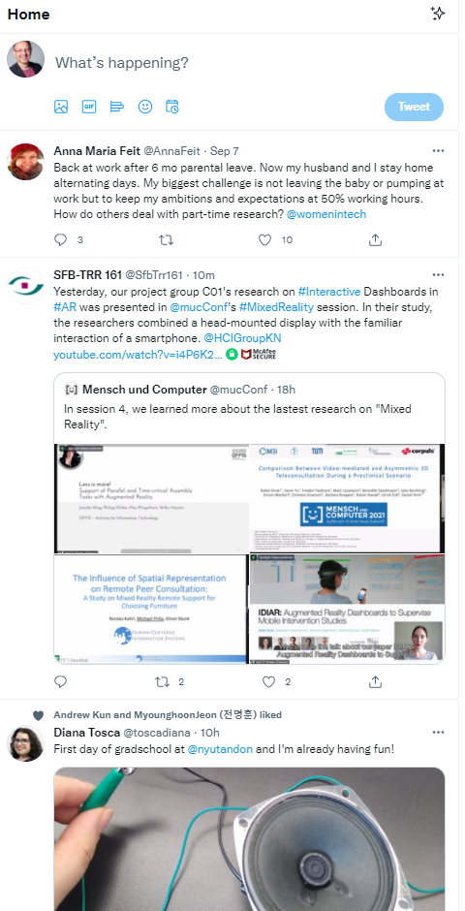
Is the Twitter-Algorithm a iHCAI?
Individuals can interact in real time with the algorithms, models, and data and can manipulate and control all relevant parameters.
The impact of changes and manipulations made by the user can be observed in real time.
In fast processes the speed can be reduced to allow interactions, interventions, and manipulation.
Individuals can interactively explore why and how specific decisions are made and find out how changes in the parameters, data, and models impact outcomes.
It states how humans can benefit from the artificial intelligence.
It explains what risks the artificial intelligence poses for individuals as well as on societal level.
It is visible who has control of the artificial intelligence, in particular who has the power over data, models, and algorithms.
It is visible what data, knowledge base, and information is used or has been used to create and inform the artificial intelligence.

Slide 36
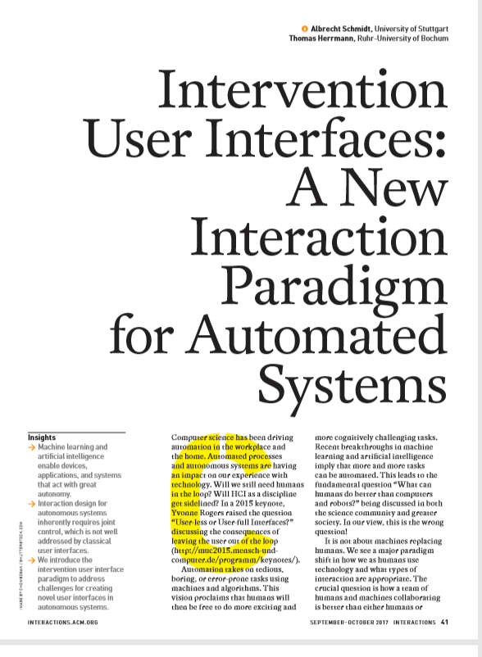
How can humans stay in control?
In the future, we believe that a large class of automated and autonomous systems allow for joint control, where the majority of decisions are automated but where users can intervene.

Slide 37
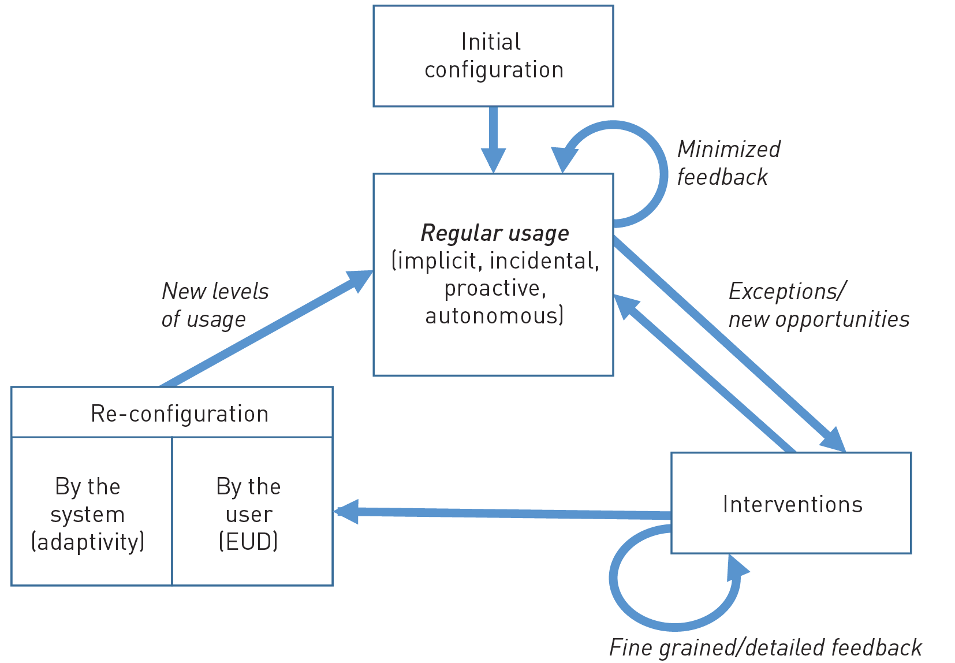
Interaction with Intervention User Interfaces

Slide 38
Design Principles for Intervention user interfaces
For more details and
a set of rules see:
Ensure expectability and predictability.
Communicate options for interventions.
Allow easy exploration of interventions.
Easy reversal of automated and intervention actions.
Minimize required attention.
Communicate how control is shared.

Slide 39
The End of Serendipity?
Optimal Solutions for Everything?

Slide 40



… some things just happen
I met her accidentally and we get on well together
it was pure chance that we were there at the same time
we sat next to each other and realized we work
on the same thing
Notes:
Until now, many of our major decisions in life, such as the job we work, the people we live with, or whether and with whom we start a family, largely depend on chance and the choices we make. This may be history!

Slide 41
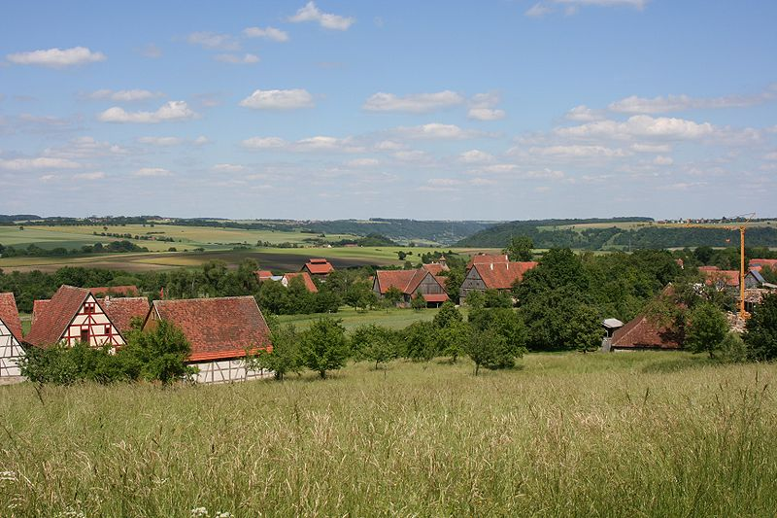
Boundaries are gone
Rosenzweig, CC BY-SA 3.0,
https://commons.wikimedia.org/wiki/File:Wackershofen_Freilandmuseum_Blick_von_oben_20070530.jpg
Notes:
Foto:Historic village
Shop, food, School, people, church
In the pre-digital age, the choice was much smaller, since you were, in most cases, essentially limited to your community (local as well as societal). These limitations applied to mundane everyday tasks, such as what and where to buy an item, as well as to big life choices of what school to go to or whom to marry. As the choice was limited, no recommender systems were required. In many cases, chance played a major role as well as the social environment people were in. Decision support, if required, was provided by friends or even by playing a chance game, such as the daisy oracle, depicted in figure~\ref{fig:teaser}, where you alternate choices (e.g. yes, no, yes, no, etc.) while pulling off petals, till all are gone.

Slide 42
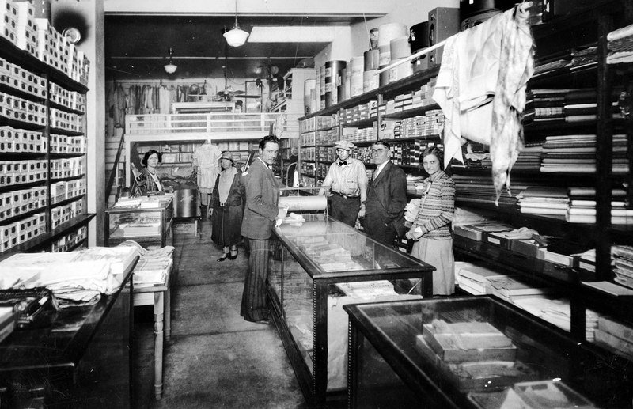
Choice has increased
Jim Evans, CC BY-SA 4.0, https://commons.wikimedia.org/wiki/File:Cochran%27s_Dry_Goods.tif

Slide 43
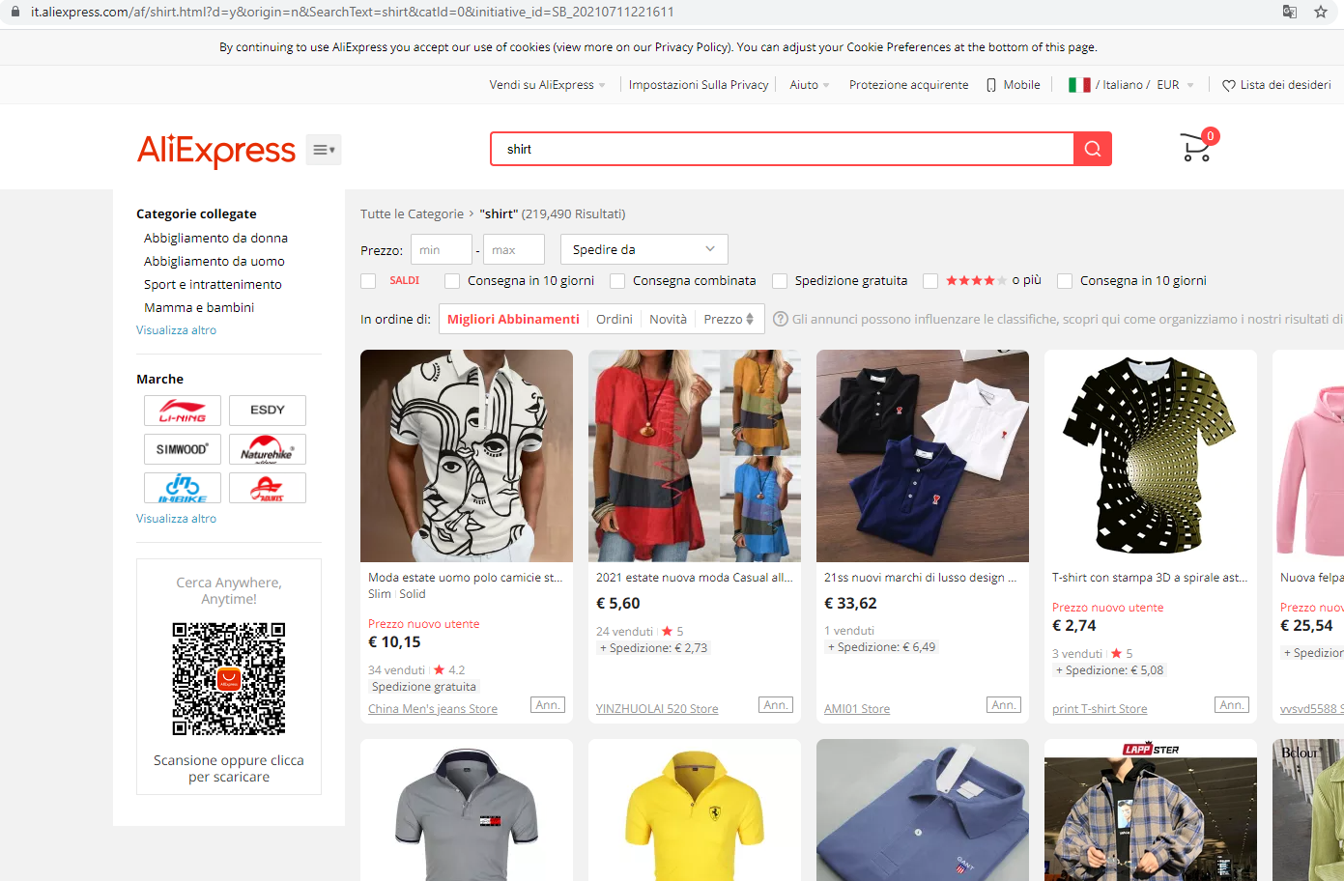
Unlimited content, impossible choice
Notes:
We have gotten used to being supported in our decisions since the early days of the WWW. In the 1990s, there were still web directories (e.g. Yahoo!) that made an effort to create human-curated, hierarchically organized categories of links to websites. It was apparent that this could not scale to the content on a WWW scale. Directories and also search engines only provide access to a fraction of the available content.
In \cite{ilprints422}
the PageRank algorithm is described (which was at the foundation of Google) as "a method for rating Web pages objectively and mechanically, effectively measuring the human interest" highlighting the challenge of finding what is important.
Without algorithmic support for selecting the content that we focus on, most of the popular websites and social media applications would not work. Letâ€™s illustrate the scale of this challenge: The search query â€œBolzanoâ€ on Google lists 37 million hits. We know that users typically look at the first 10 hits on a search page and even the order on within the first hits significantly impacts the users' choice \cite{keane2008people}. There are no â€œrightâ€ 10 to select out of the 37 million. Nevertheless, what is put on the top of the first page will get the attention.

Slide 44
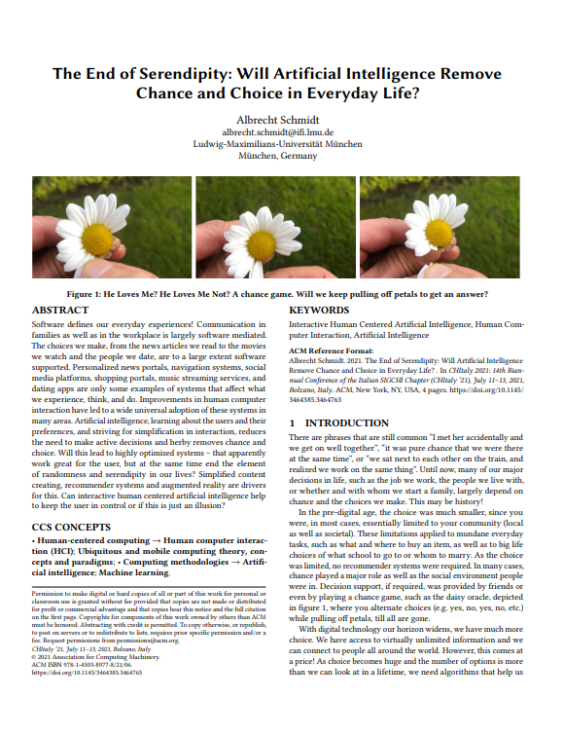
Content Selection Dilemma
… random selection of content would not work
We need algorithms, which will inevitably introduce bias, manipulate us, and reduce choice and serendipity.
This also leads to the question of who has control over algorithms?
https://uni.ubicomp.net/as/as-chocie.pdf

Slide 45
There is a dilemma: We cannot consider all options as this would take forever.

Slide 46
Is Human in the Loop the Solution?
Who makes the real decisions?
1.000.000
Options
100
Options
In a sorted list
1 Item –
My selection
AI / Algorithm
Human
Notes:
Such decision support systems may still have the human in the loop. They preselect and let us choose between options that are similarly optimal with regard to our preferences (or the cost function used for optimization). Pruning the search space will make it easier to find what we like, but at the same time, it limits our personal choice massively. Apparently, a good system will be designed to not offer inefficient or suboptimal solutions to the user.

Slide 47
But it feels all real,
I am in control!

Slide 48
Is Human in the Loop the Solution?
How makes the real decisions?
1.000.000
Options
100
Options
In a sorted list
1 Item –
My selection
AI / Algorithm
Human
Notes:
Such decision support systems may still have the human in the loop. They preselect and let us choose between options that are similarly optimal with regard to our preferences (or the cost function used for optimization). Pruning the search space will make it easier to find what we like, but at the same time, it limits our personal choice massively. Apparently, a good system will be designed to not offer inefficient or suboptimal solutions to the user.

Slide 49
Manipulate vs. Intelligent Assistance

Slide 50
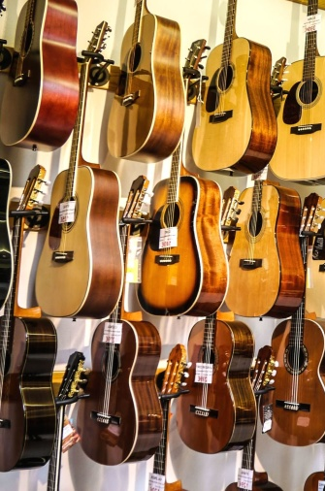
Manipulation is Easy
(and it is not new)
Your get 4 items presented:
  one that is out of your budget
  one that has low user ratings
  one that is not available until next week
  one we want to sell you
It is your choice!
You will believe, that you made your choice
However the system “manipulated” the decision
  Pre-selection
  presentation
Notes:
https://pixnio.com/objects/guitar-shop-music-instrument-wire-acoustics

Slide 51
Manipulation or Intelligent Assistance?
The interface of how to present intelligent assistance to the user is critical for success
“Users don’t want to be told what to do, they want to choose”
  Version 1:
    “take the train at 12:17 from platform 6”
  Version 2:
    “which do you want to take? train at 12:17 from platform 6 (takes 45 minutes) or bus at 12:15 from platform 3 (takes 50 minutes, is unreliable)”
Intelligent assistance is not perfect (and will not be for a long time), and this can be hidden in the user interface

Slide 52
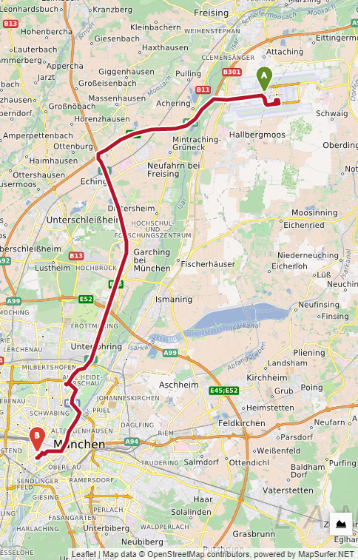
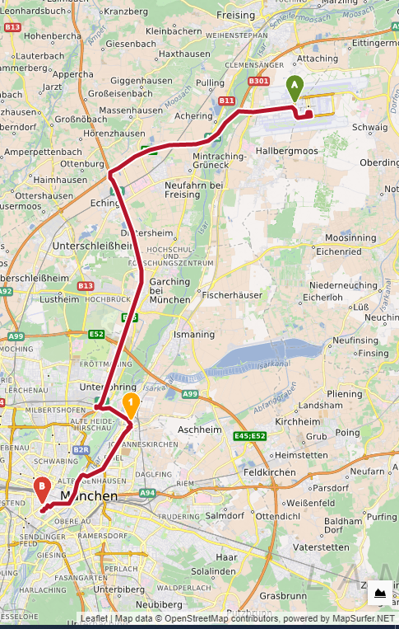
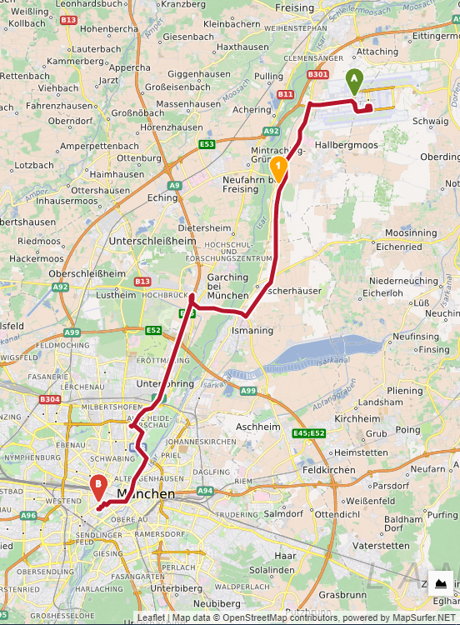
A Dystopian vision: The route you drive
Notes:
{\it Where to drive?} The navigation system impacts our actions and perception. It can pick routes that bring us close to certain locations (and stores) and keep us away from other parts of the town. Depending on the route, we may never see a homeless person, even though they are there. Who makes the decision on what you should be exposed to when you drive? With power over your route it is easy to manipulate where you shop and how safe you feel.

Slide 53


A Dystopian vision: What to eat?
Notes:
{\it Where to eat?} Search sites (e.g. Yelp) can easily nudge you to visit some restaurants and avoid others. They can increase the chance of people meeting in a restaurant, while having the power to make sure they will never meet when going for dinner. Hence, further separating groups in society seems really easy to implement.

Slide 54
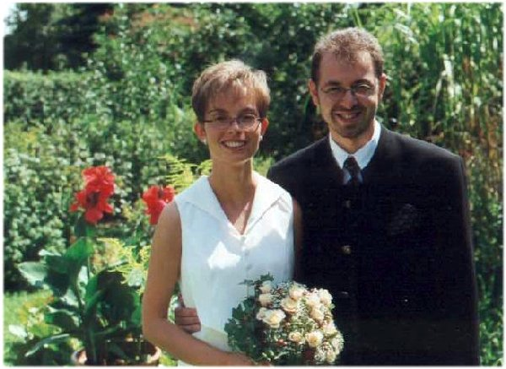
A Dystopian vision: Fundamental life choices
Whom to marry?
Notes:
{\it Whom to marry?} Who will you have a relationship with? Who will choose the person you start a family with? In the digital age, your choice of potential partners for life is huge, even if you limit it to a geographical area. Dating sites use algorithms to reduce the choice from several thousand to 10 or maybe 50. The UI and the interaction design (in particular, how potential partners are presented, when you receive notifications, and communication channels provided) will further impact the user choice. Access to the algorithm and interface can become the basis for a new human breading experiment. Scary!

Slide 55

The (predictive) power of computing
Can we predict your future?
Where you go next?
What you will order?
What you will watch?
…
The (life-)partner you choose?
…
Notes:
Abraham Lincoln
https://www.pxfuel.com/en/free-photo-jgfkb
CC0 1.0 Universal (CC0 1.0)
Public Domain Dedication

Slide 56
The (predictive) power of computing
Can we predict your future?
Where you go next?
What you will order?
What you will watch?
…
The (life-)partner you choose?
…
The best way to predict
the future is to create it
Notes:
Abraham Lincoln
https://www.pxfuel.com/en/free-photo-jgfkb
CC0 1.0 Universal (CC0 1.0)
Public Domain Dedication

Slide 57
The (predictive) power of computing
Can we predict your future?
Where you go next?
What you will order?
What you will watch?
…
The (life-)partner you choose?
…
The best way to predict
the future is to create it
… for them - or at least nudge people to go into the right direction (the future you want)
Notes:
Abraham Lincoln
https://www.pxfuel.com/en/free-photo-jgfkb
CC0 1.0 Universal (CC0 1.0)
Public Domain Dedication

Slide 58
Then End of Serendipity?
No Randomness anymore?
Who do you trust to decide …
…what movies you watch? (and eventually like)
…who you are sitting next to on the plane?
…which way you walk?
…who is in the same restaurant as you?
…which flat you buy?
…
…whom you marry?

Slide 59
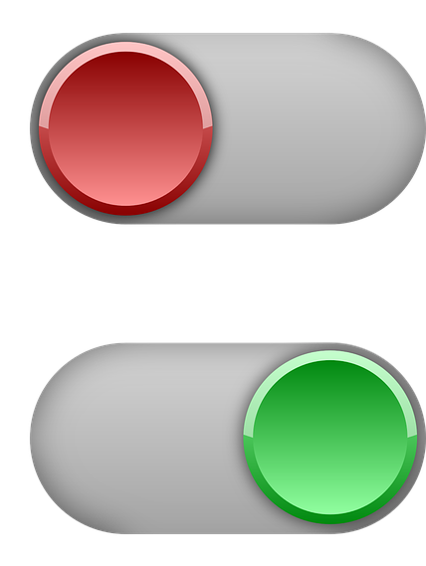
Don’t
Autoplay your Life
Off
On
Notes:
If you put YouTube on autoplay you can comfortably watch all evening long, without making any decisions but at the cost of losing control! YouTube will guess what you like and after some time you will probably like it.

Slide 60
Implementing IUIs
Practical advice

Slide 61
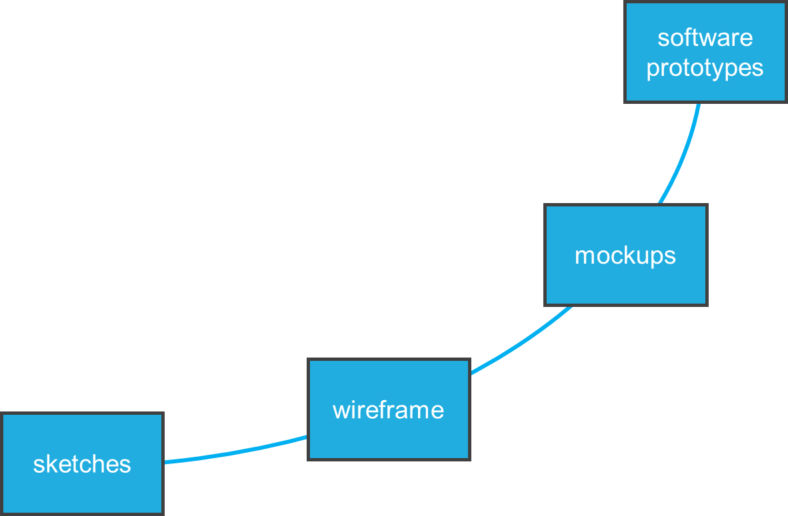
effort
design iteration
fidelity
Introduction to Prototyping

Slide 62

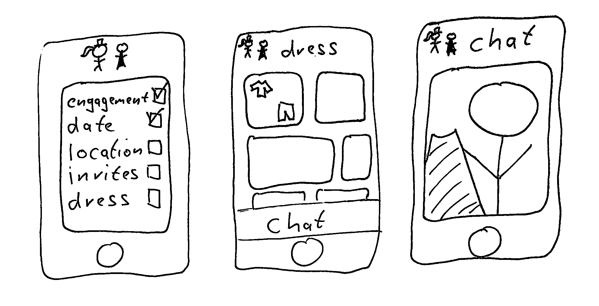
Sketches
Low-Functional Prototypes

Slide 63
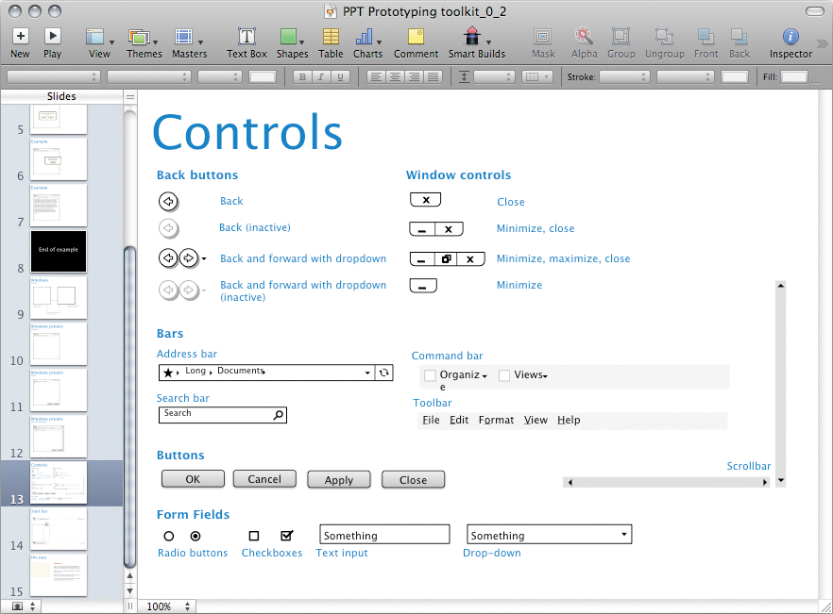
Image by Rosenfeld Media from https://www.flickr.com/photos/rosenfeldmedia/3978127831 (CC-BY 2.0)
Low-Functional Prototypes

Slide 64
ISO 9241-210 Human-Centered Design Process
Plan the human-centered design process
Design solution meets the user requirements
Understand and specify the context of use
Evaluate designs against requirements
Specify the user and organizational requirements
Product design solutions to meet the user requirements
ISO 9241-210:2019 (en) Human-centered design for interactive systems
Systemizing Prototypes

Slide 65
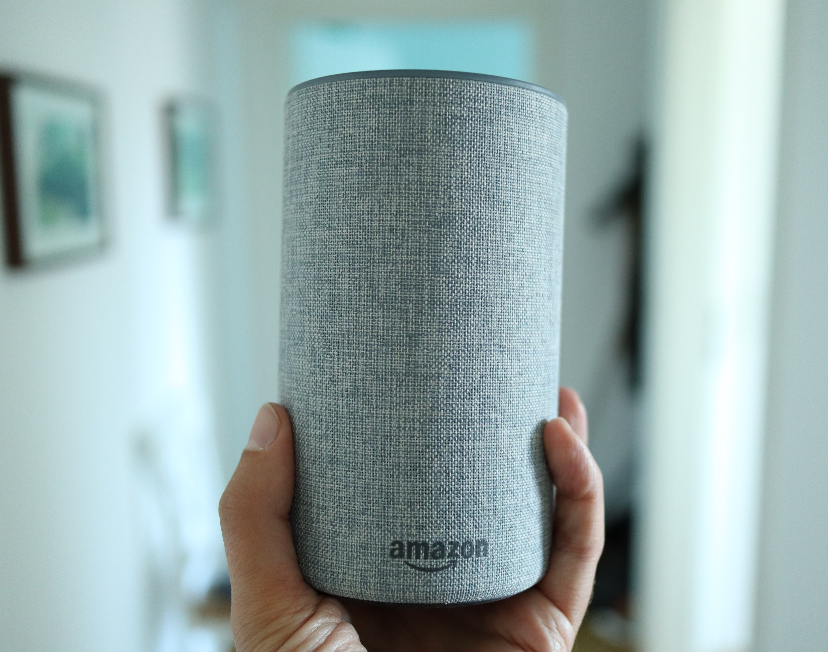
Prototyping IoT devices
How would you build a prototype?
In an hour?
In a day?
In a week?
Wizard of Oz Prototypes
Notes:
Introduced November 2014
Siri: October 2011

Slide 66
Development is hard – not testing is harder
Often unclear if a system is worth the development effort
Especially true for systems requiring novel hardware or algorithms
Learning if the system is useful and the functions users want requires the system
Wizard of Oz Prototypes

Slide 67
Wizard of Oz
An invisible ‘wizard’ controlling parts of the functionality
We only implement the easy parts but leave the hard part to the human operator
Provides the user with the experience without extensive implementation effort for the prototype
Typical areas
  Speech recognition
  Speech synthesis
  Annotation
  Reasoning
  Computer vision
Wizard of Oz Prototypes

Slide 68

Implementing IUIs
Libraries, Python, web services, …
Pro:
Full flexibility,
integrate own models or models from others etc.
Con:
More development work, computational costs
Build your own, e.g.:
  Web-based frontend
  Python backend
  (e.g. using ML libraries)
Pre-built, e.g.:
  External APIs, web-services
  Devkits, e.g. https://developers.google.com/ml-kit
Pro:
Faster prototyping
Con:
…if it fits your needs;
API costs

Slide 69
Implementing IUIs
ML models
HCI & user-centred work is often iterative, uses prototyping
Training e.g. state-of-the-art text or image generator from scratch is costly (time + computation)
Prototyping with pretrained models
  NLP e.g.: https://huggingface.co/
  Other models e.g.: https://www.tensorflow.org/resources/models-datasets
  Many (ML/AI) papers come with code/model releases
  (e.g. https://paperswithcode.com/)
Also: „Buying a time machine“ for IUI research
Models don‘t need to run on your target device
cf. Hudson and Mankoff 2014

Slide 70
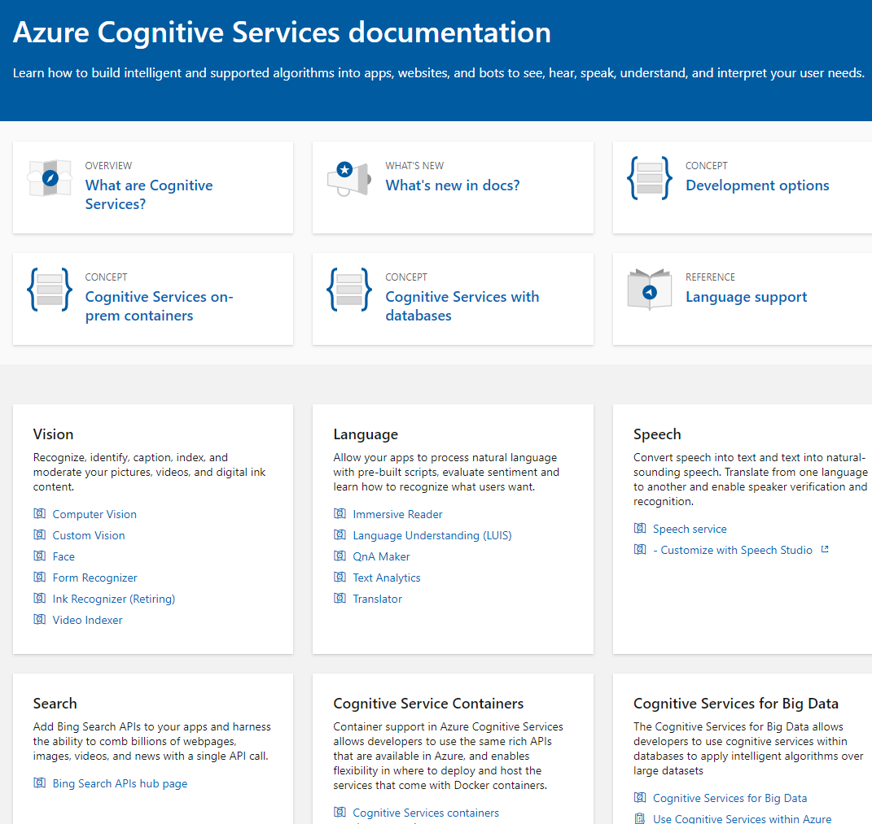
Cloud Services
Example: Microsoft Cognitive Services
Cloud Services from:
IBM
Google
Amazon
Microsoft
… and many others
Why do people use them?
What is the risk?
https://docs.microsoft.com/en-us/azure/cognitive-services/

Slide 71
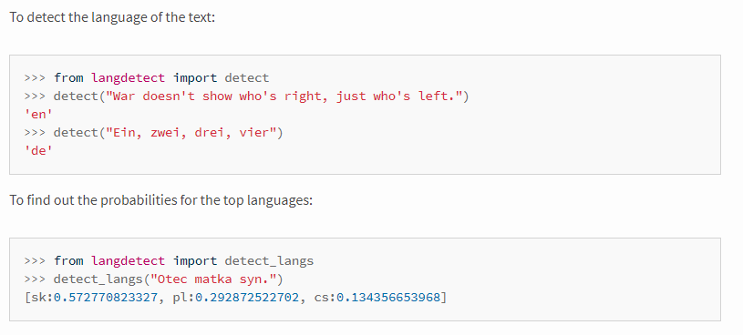
Examples Text Analytics
Identification of the Language
Can tell what language the text is, e.g. English, German, Spanish,…
Relevant for understanding and translation
Example (Online) APIs:
  https://console.bluemix.net/apidocs/language-translator
  https://docs.microsoft.com/en-us/azure/cognitive-services/translator/
  https://cloud.google.com/translate/docs/basic/detecting-language
  https://pypi.org/project/langdetect/

Slide 72

License
This file is licensed under the Creative Commons Attribution-Share Alike 4.0 (CC BY-SA) license:
https://creativecommons.org/licenses/by-sa/4.0
Attribution: Albrecht Schmidt, Andreas Butz, Sven Mayer, Luke Haliburton, and Jesse Grootjen
This lecture is partly based on the 2020 version IUI “Lecture 01: Introduction and Motiviation” by Daniel Buschek (University of Bayreuth), Andreas Butz (LMU Munich), Niels Henze (University of Regensburg), Sven Mayer (LMU Munich), and Albrecht Schmidt (LMU Munich),

